Slide 1
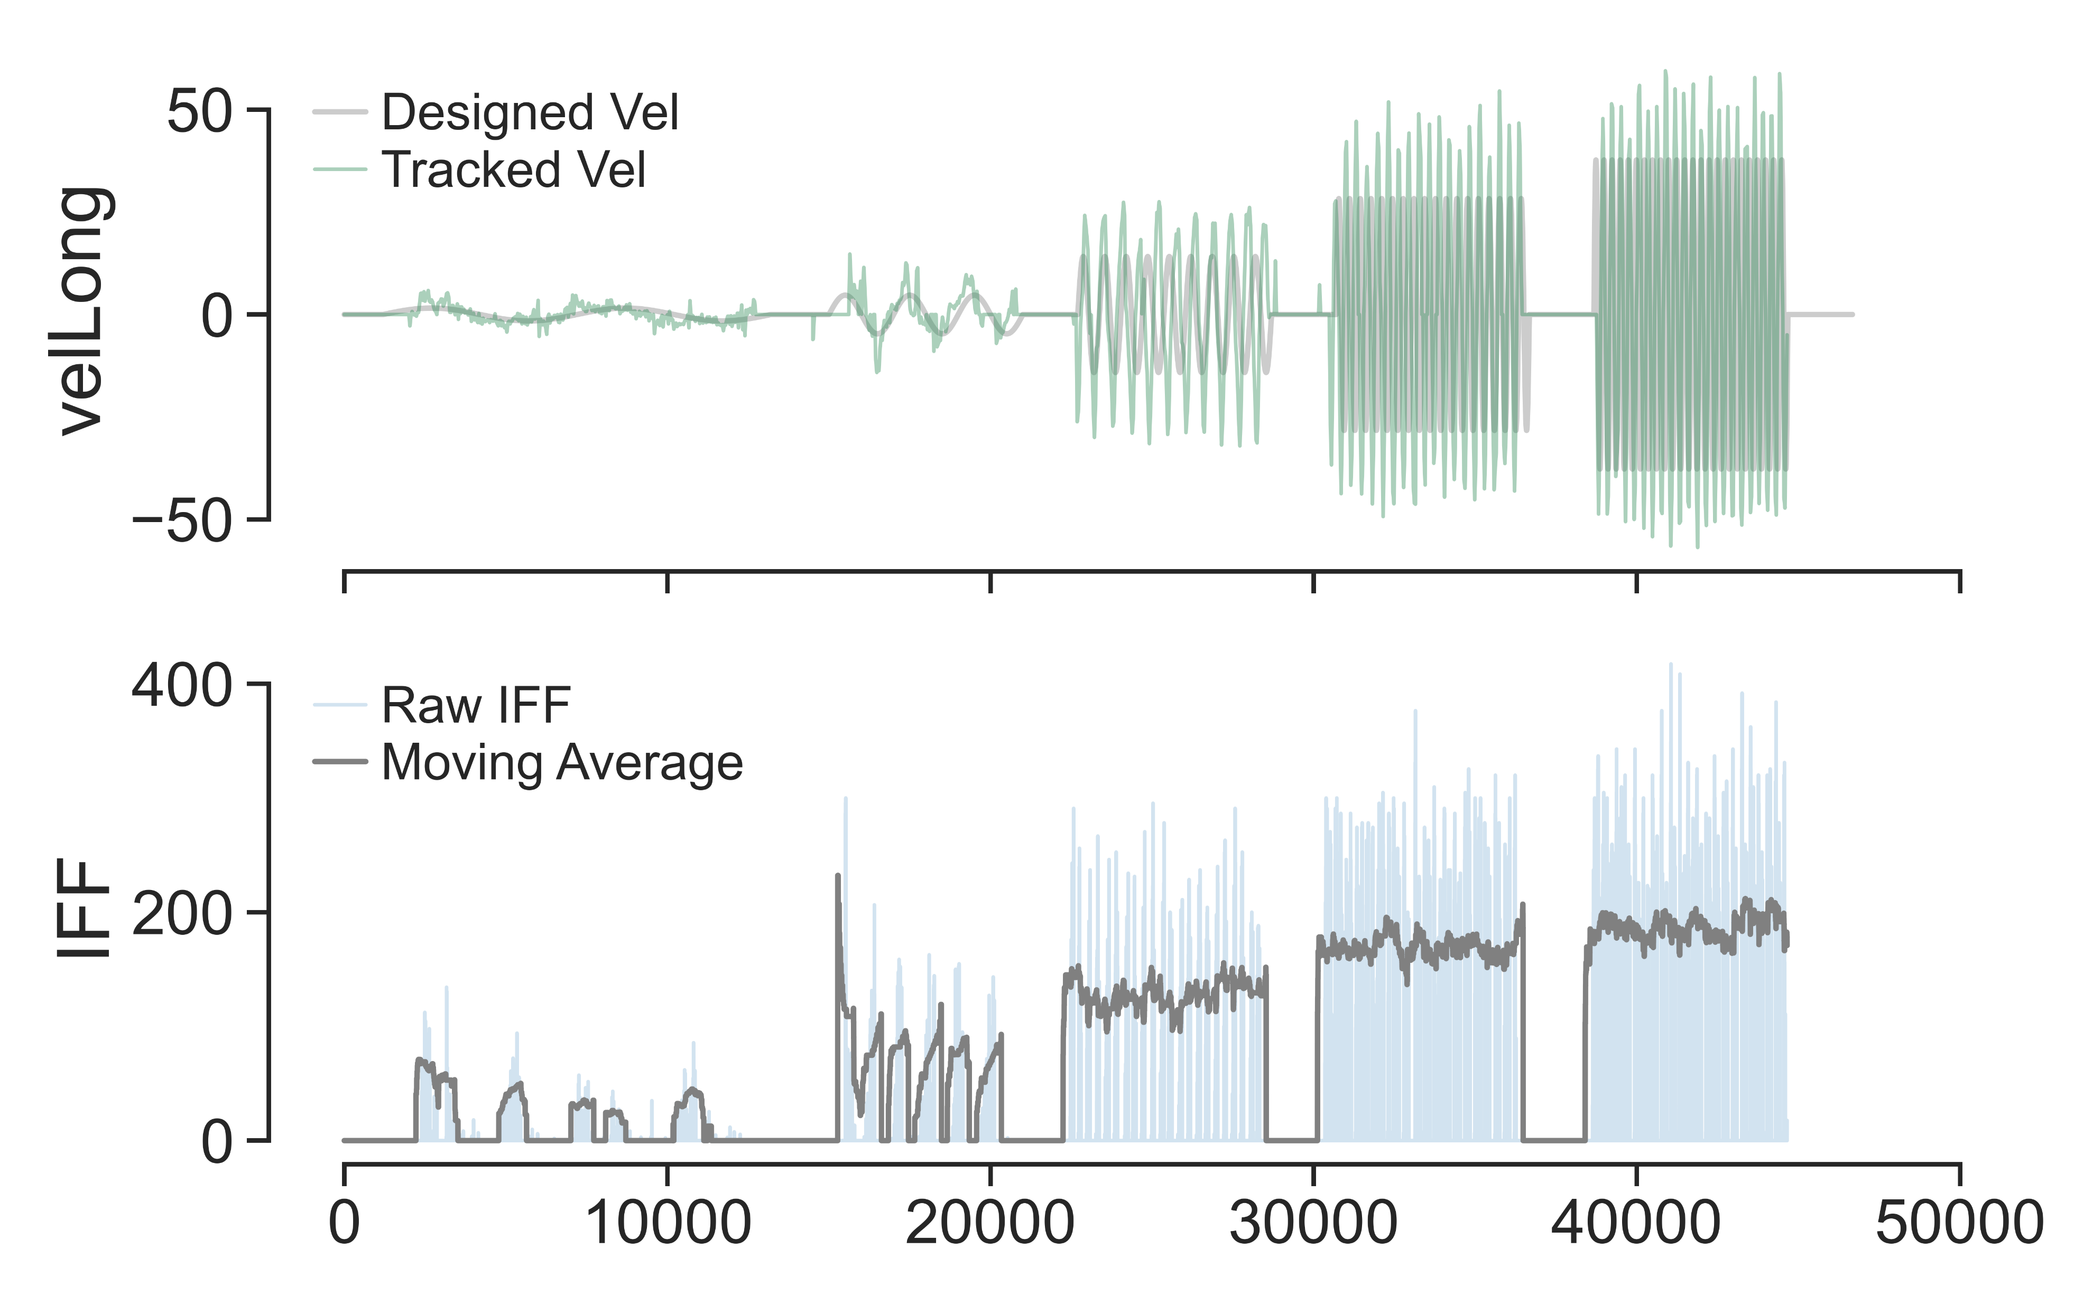
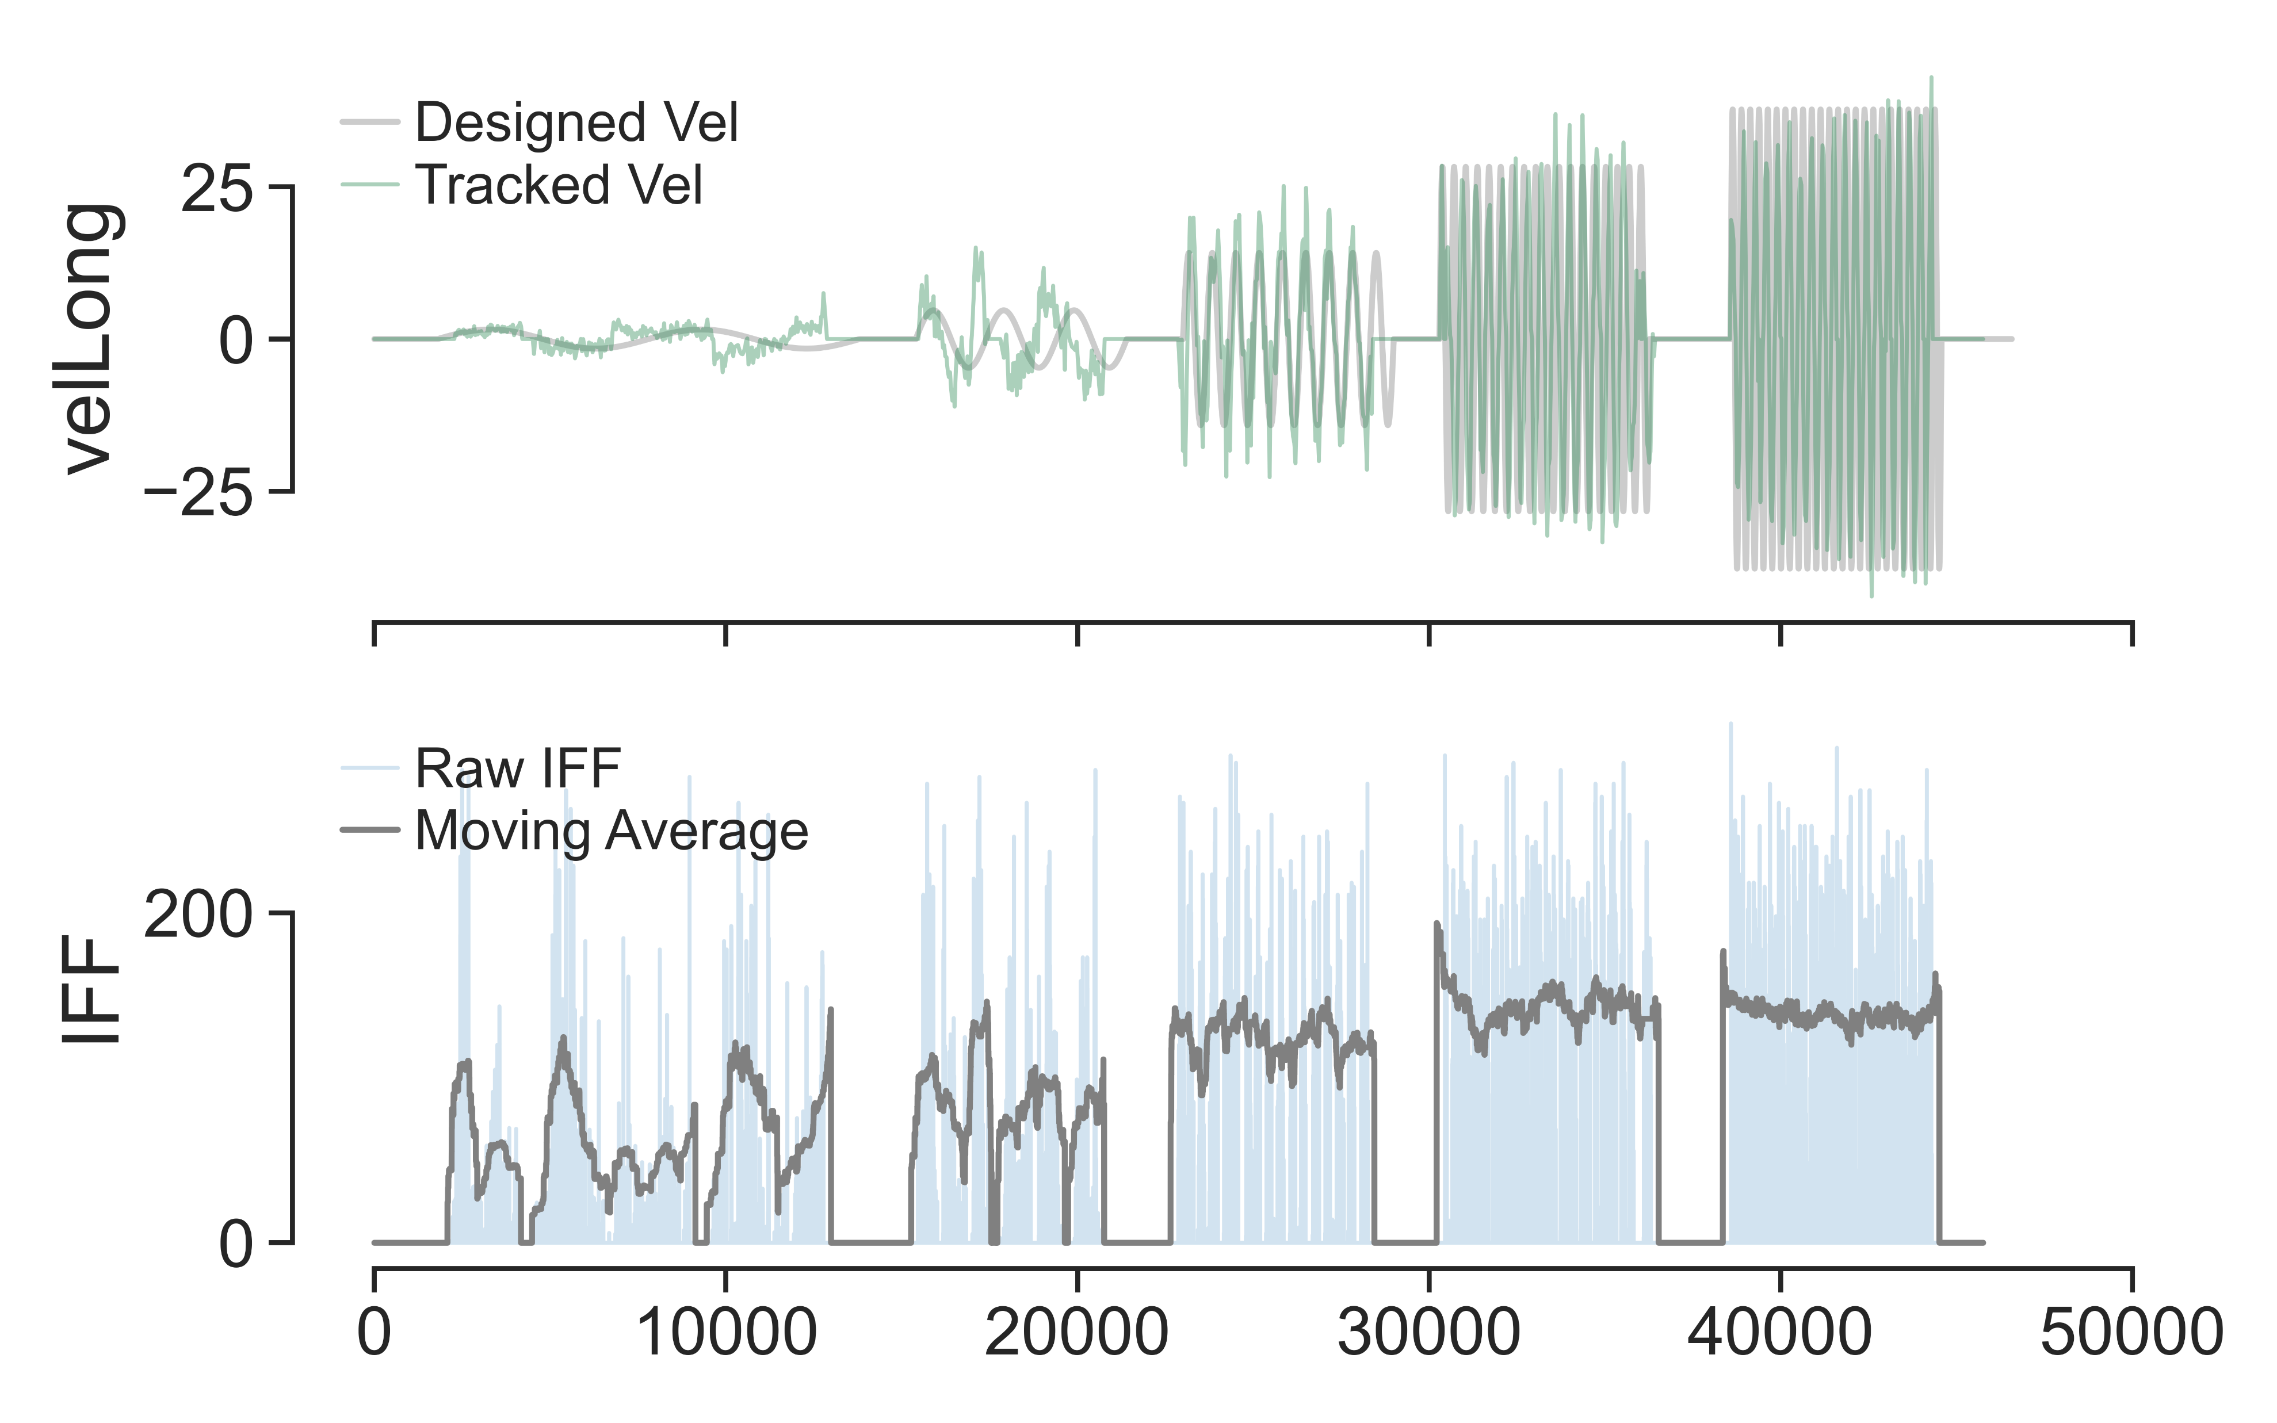
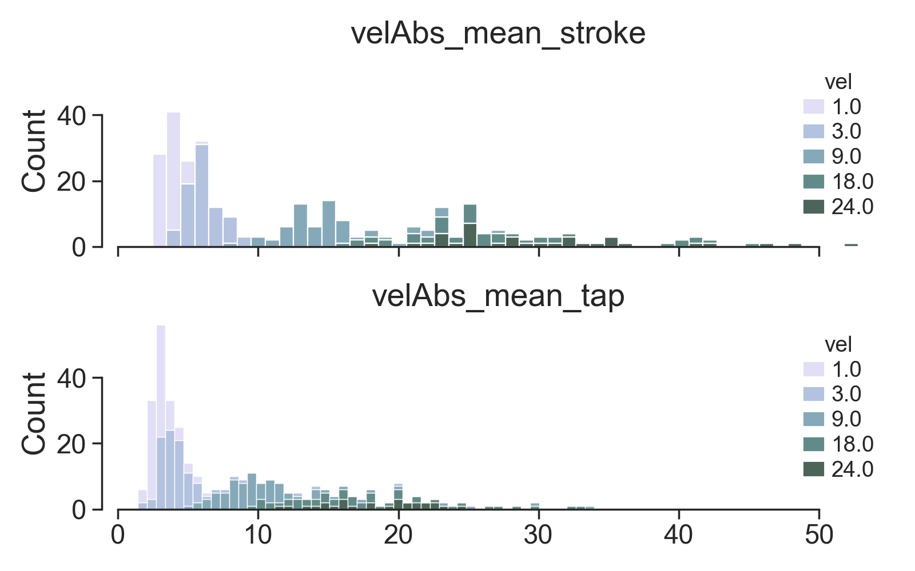
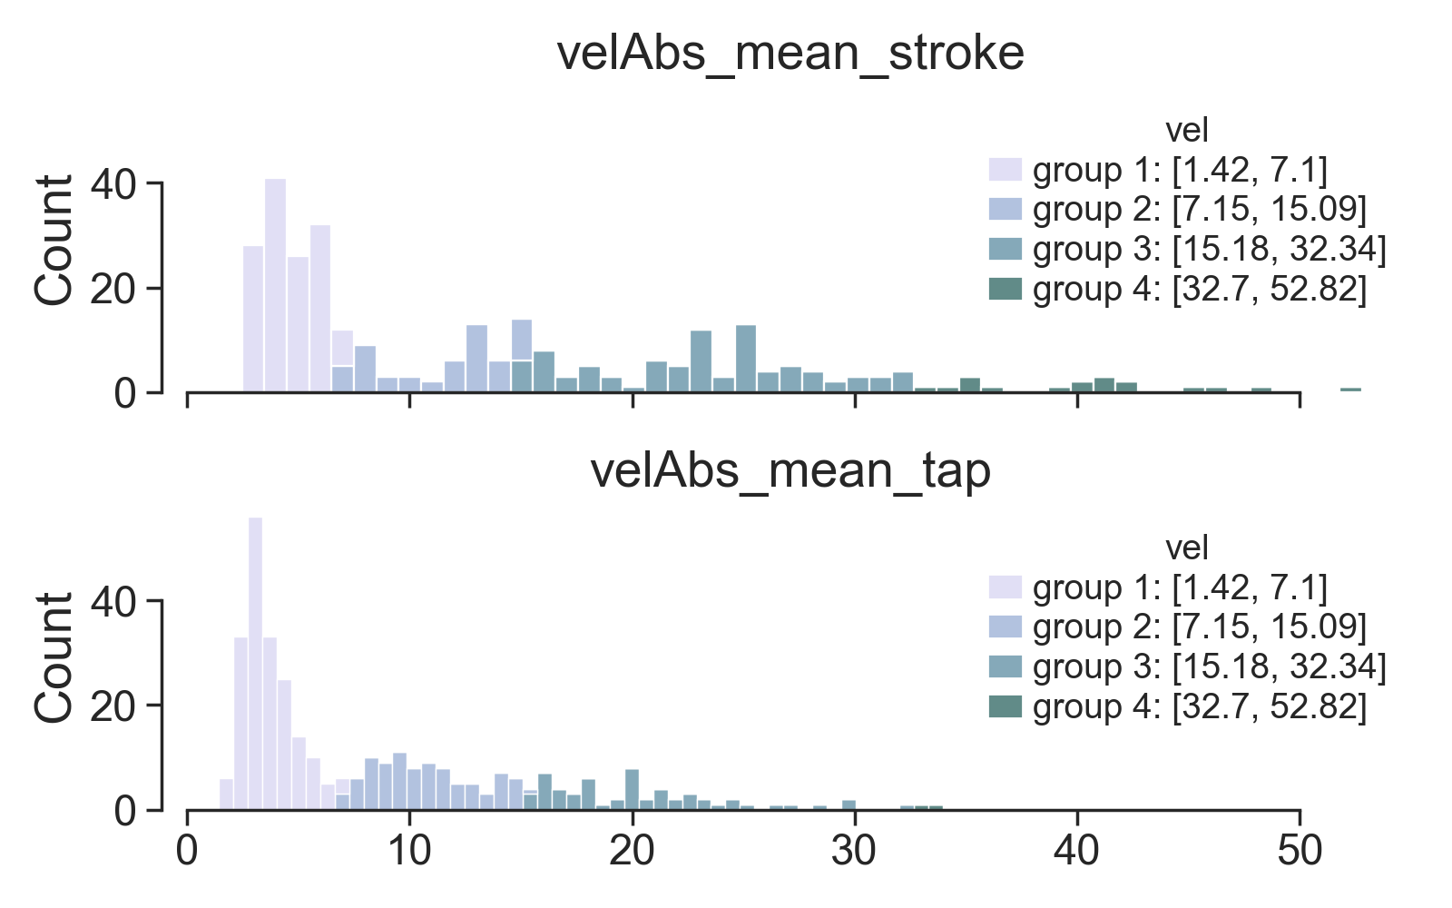
SAI
HFA
Notes:
Upper figure:
semi_control_IFF_stats.py
plot_example_TS()
Bottom figure:
semi_control_IFF.py
adapt_contact_condition(method='actual', split_gesture=False, per_repeat=False)
adapt_contact_condition(method=VarGaussianMix', split_gesture=False, per_repeat=False)

Slide 2
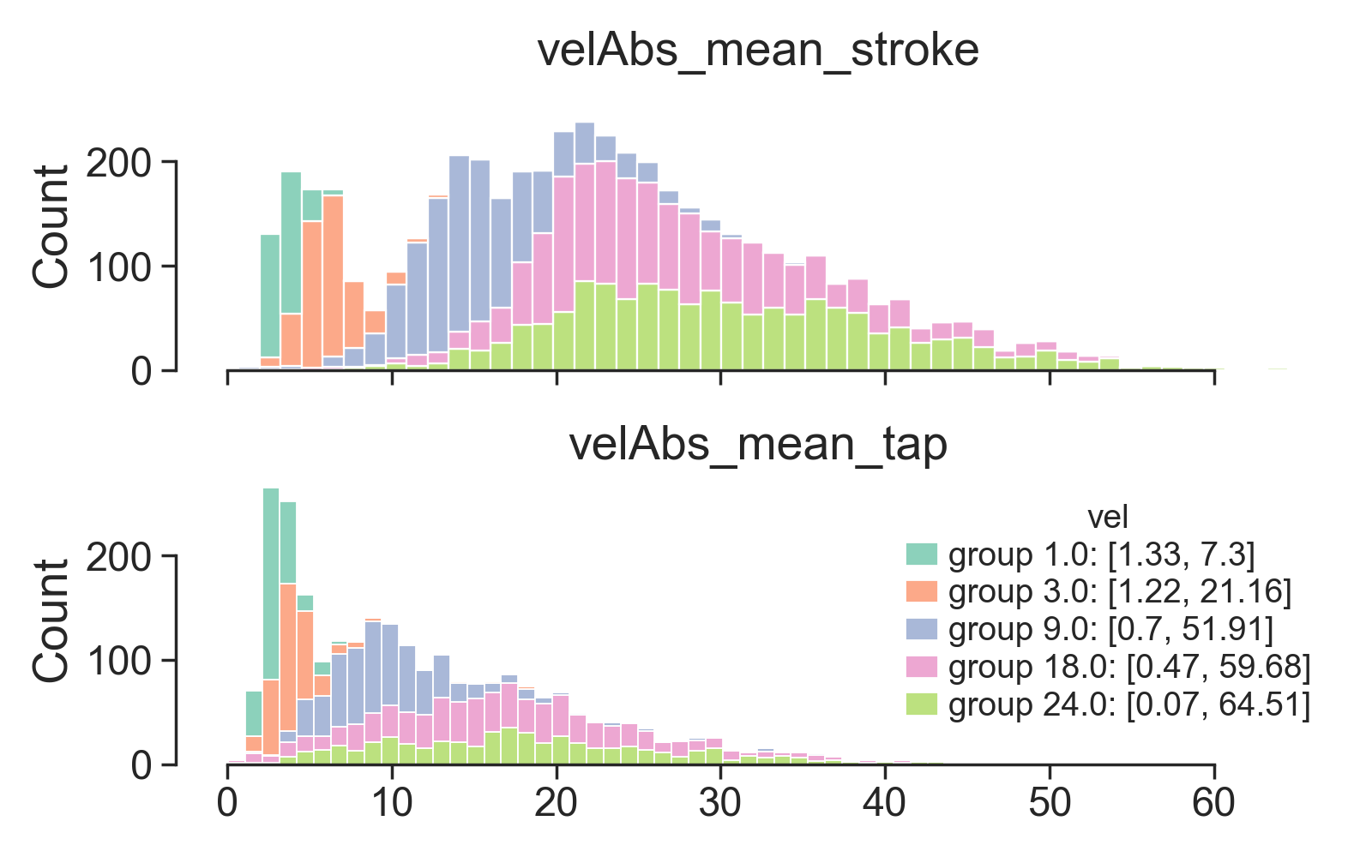
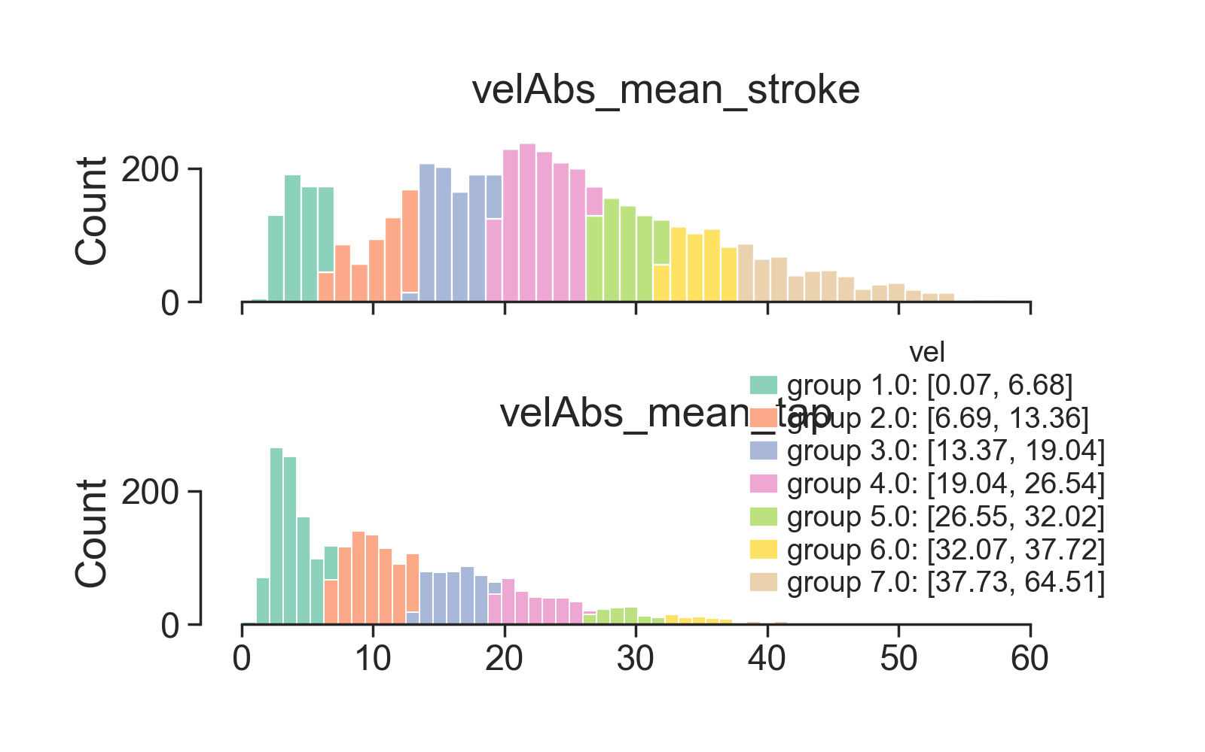
SAI
HFA
Notes:
Upper figure:
semi_control_IFF_stats.py
plot_example_TS()
Bottom figure:
semi_control_IFF.py
adapt_contact_condition(method='actual', split_gesture=False, per_repeat=True)
adapt_contact_condition(method=‘VarGaussianMix', split_gesture=False, per_repeat=True)

Slide 3
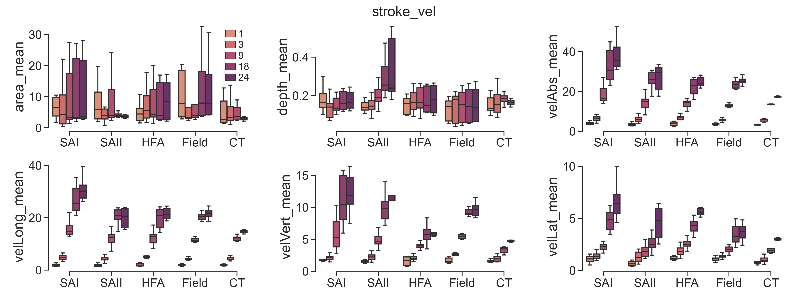
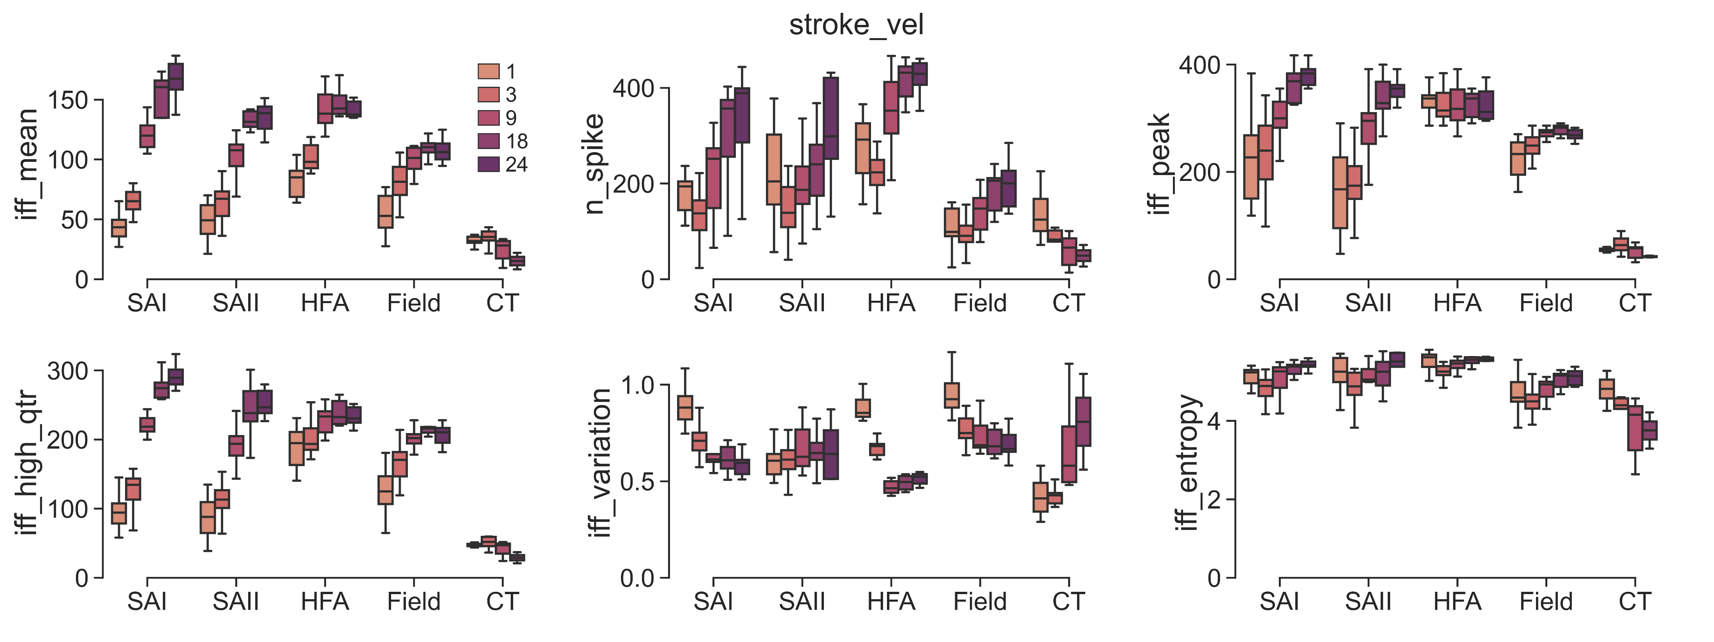
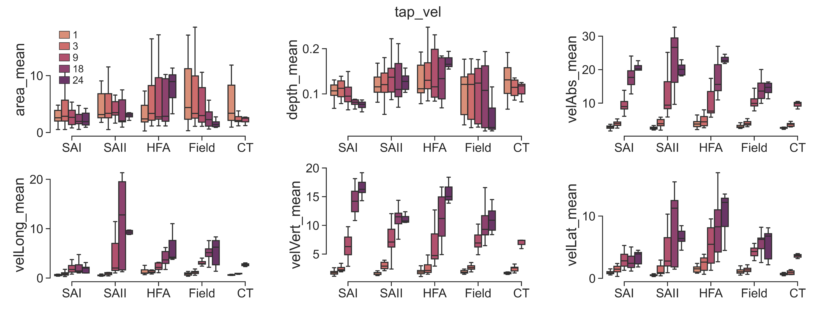
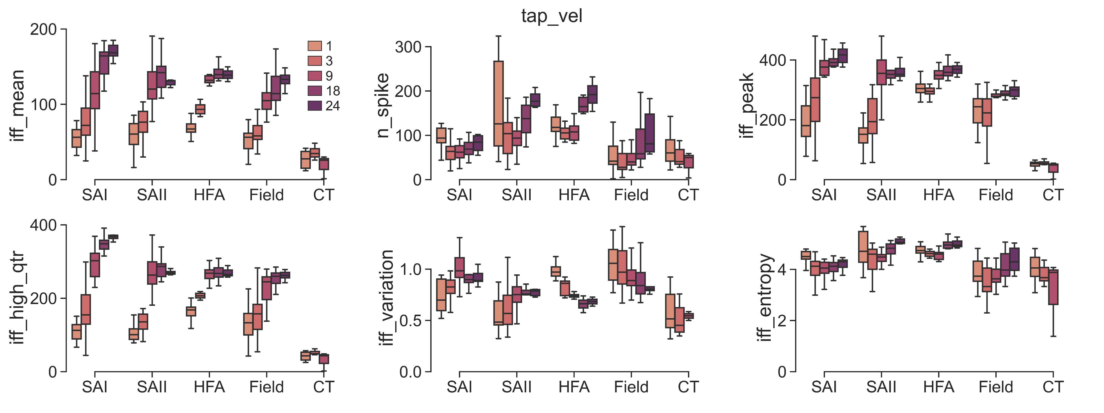
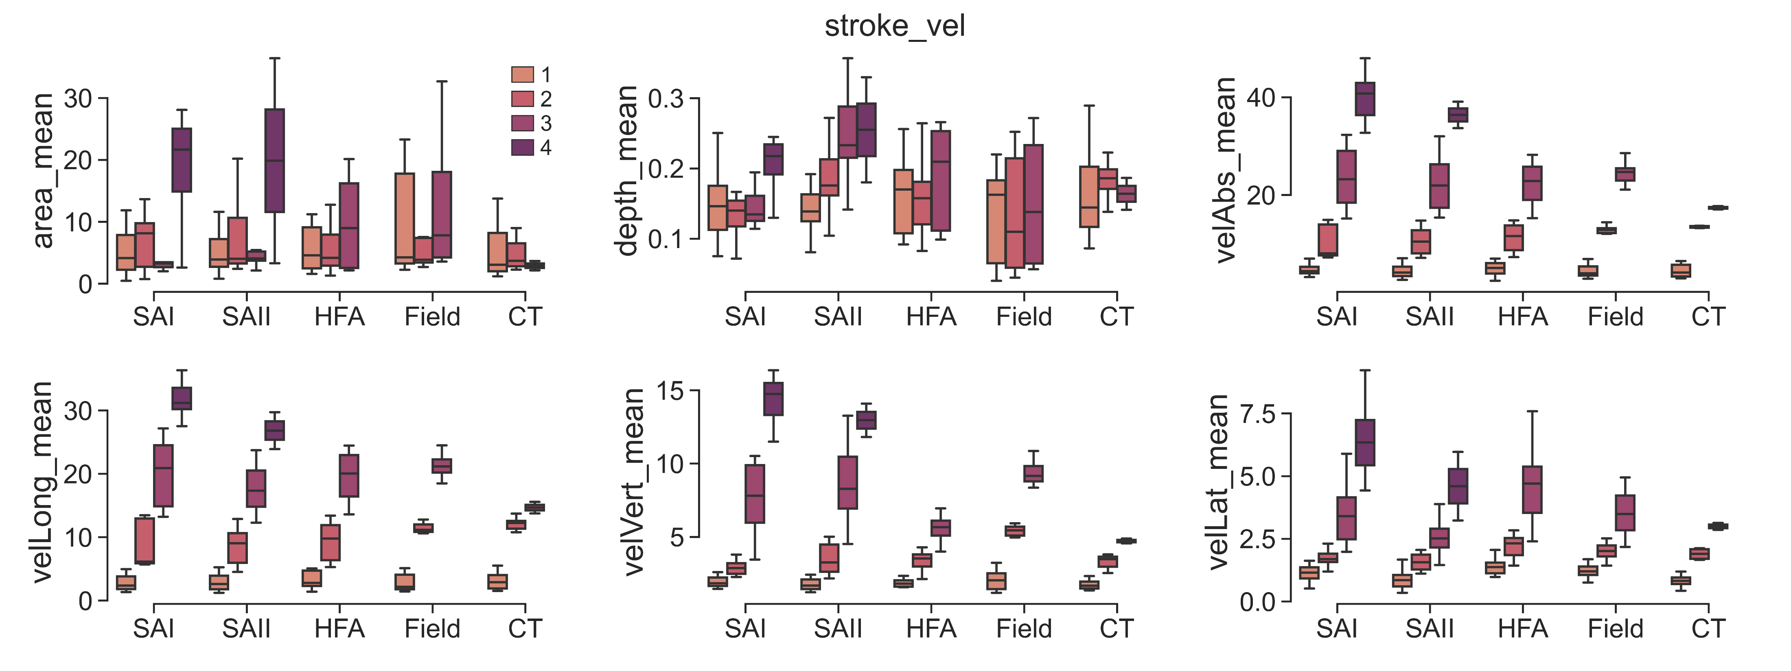
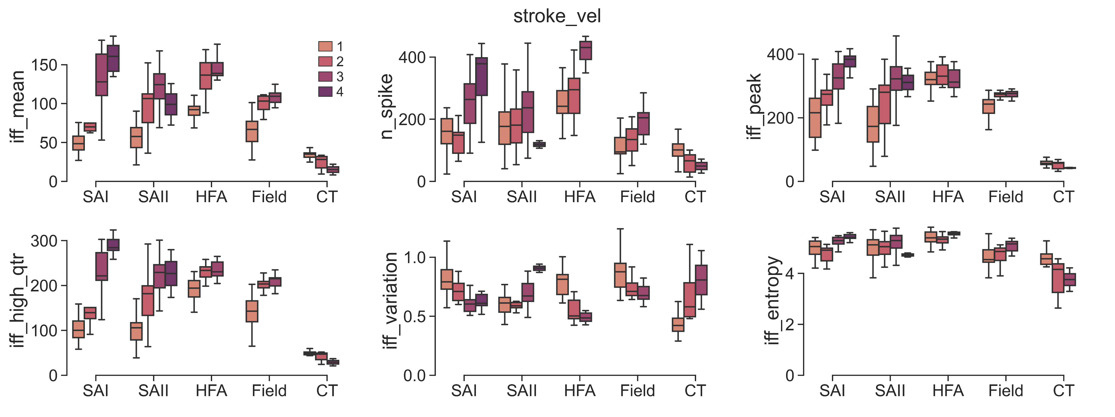
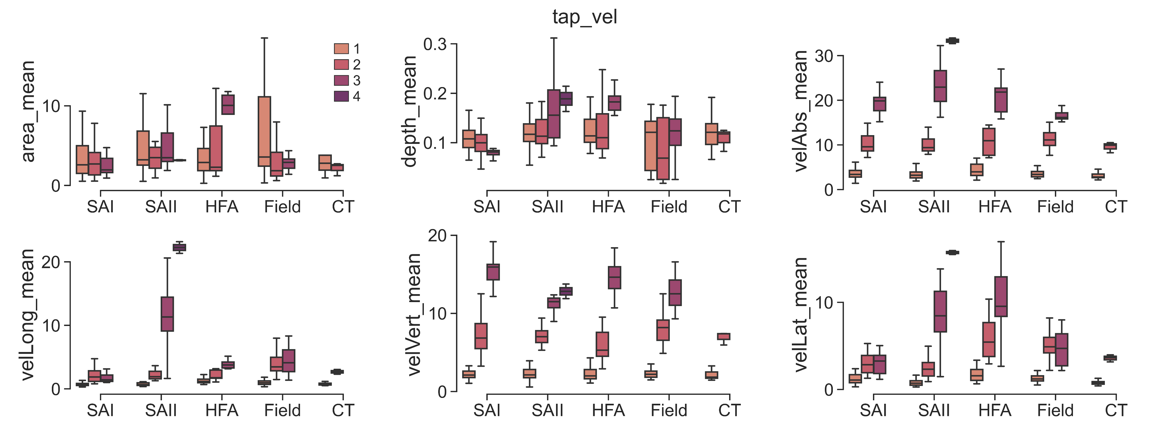
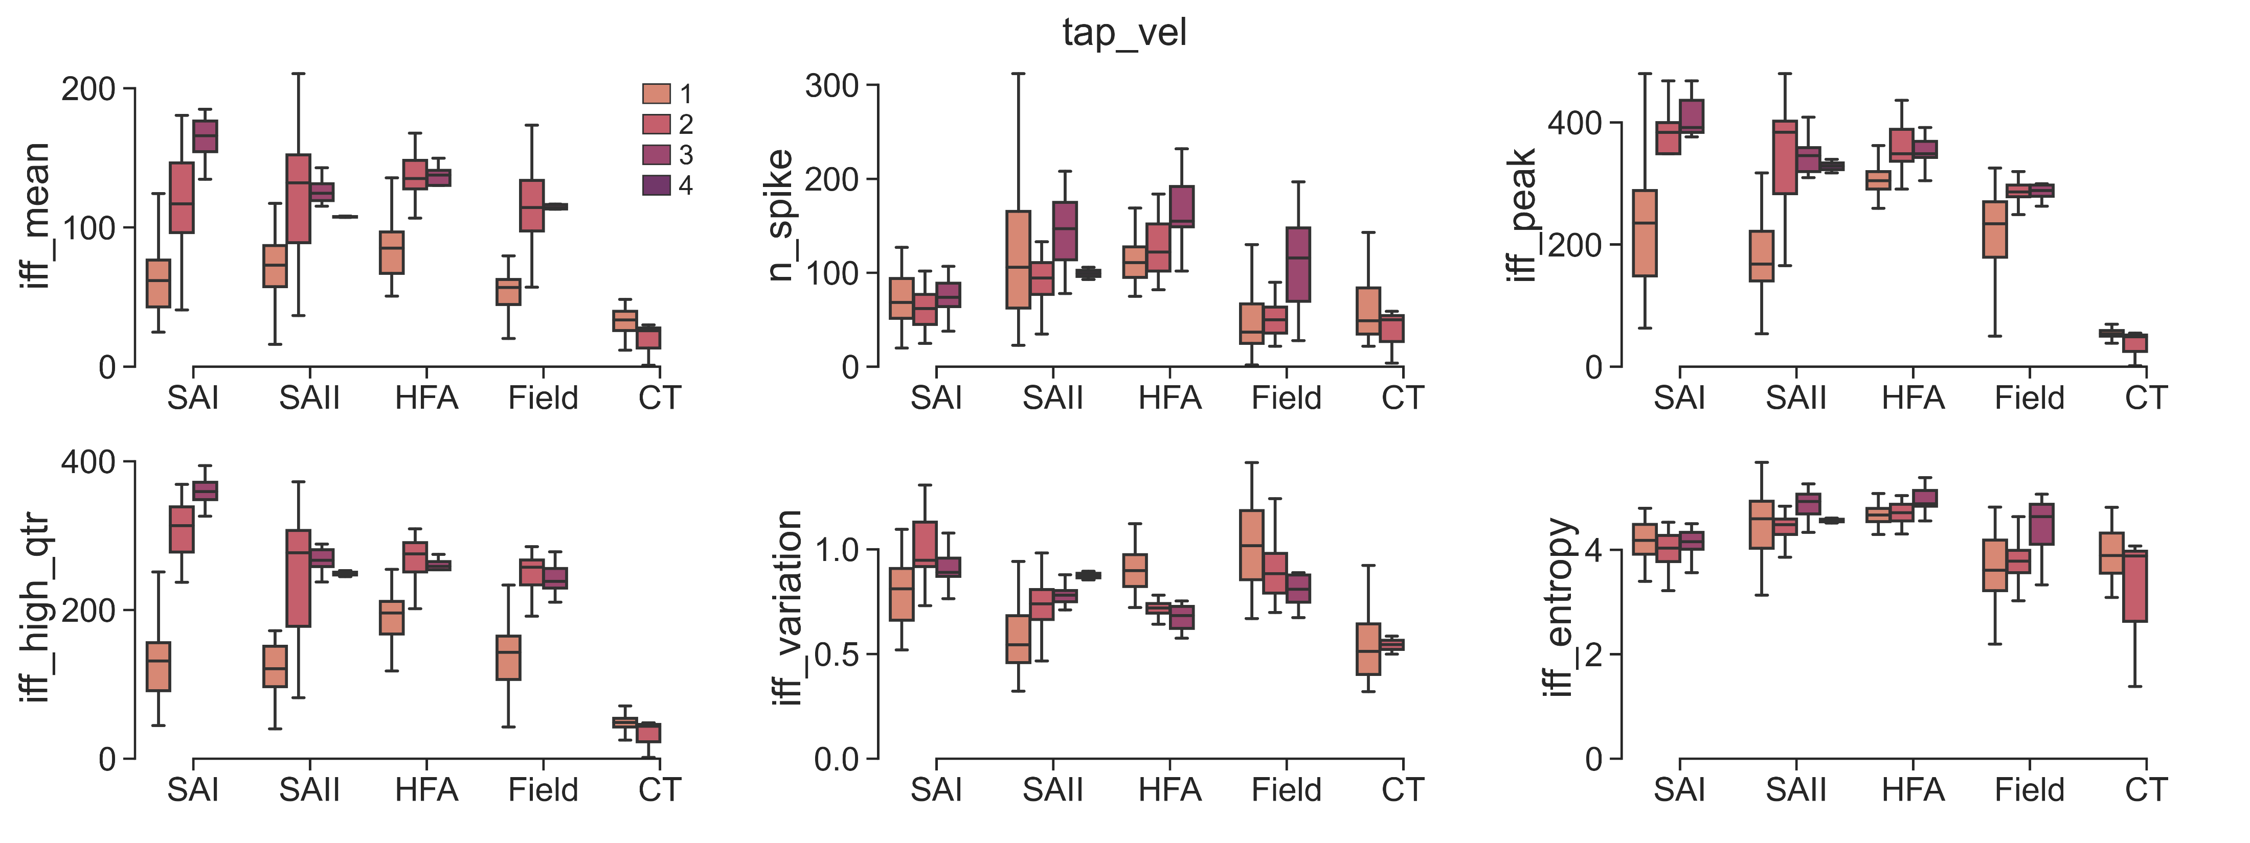
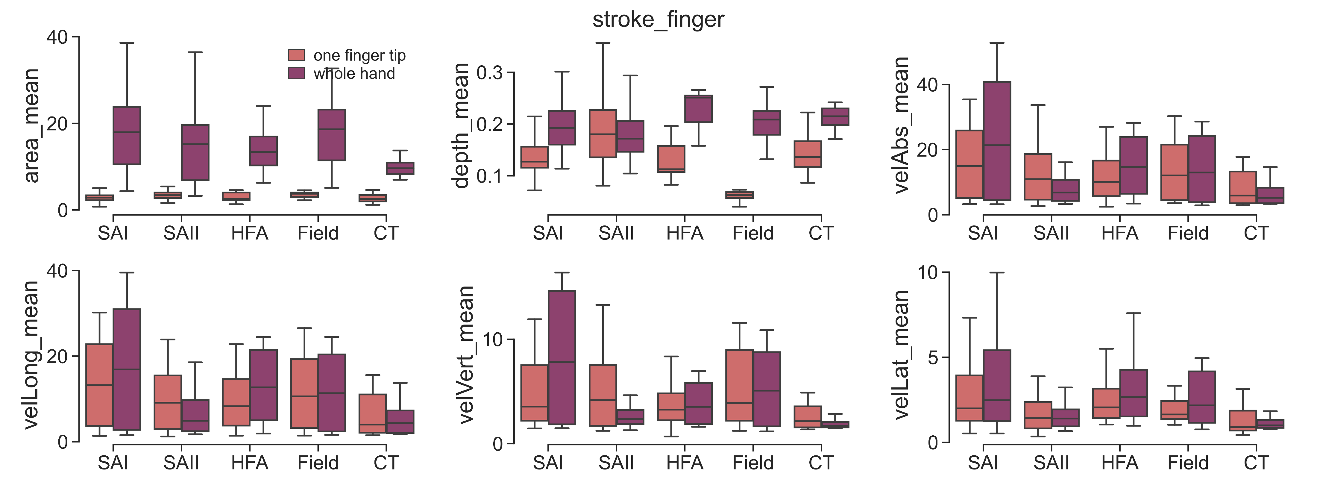
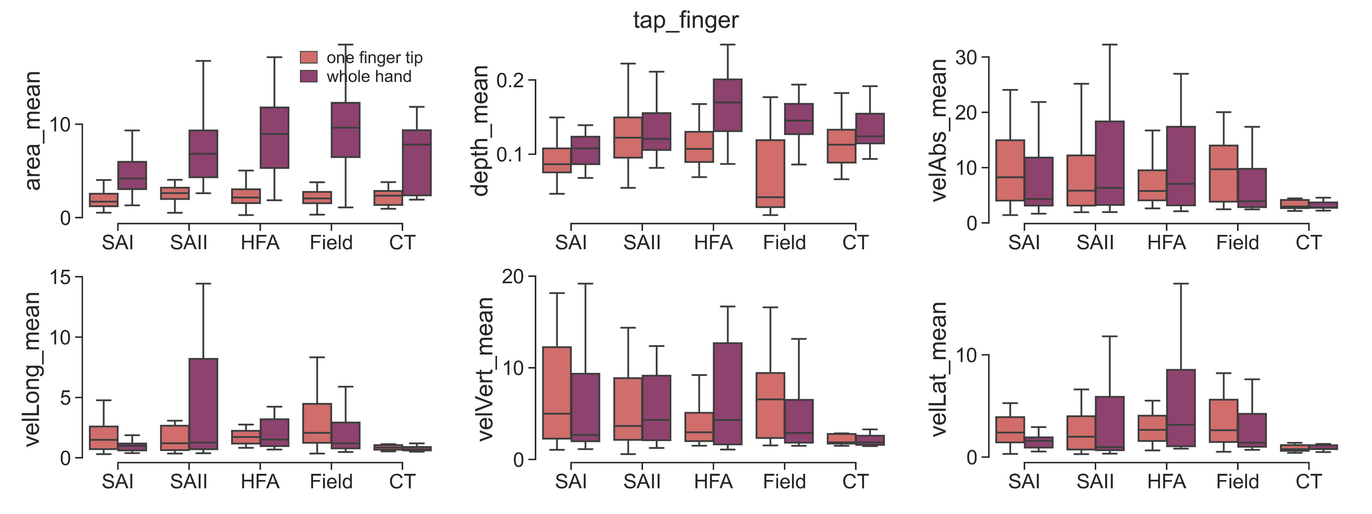
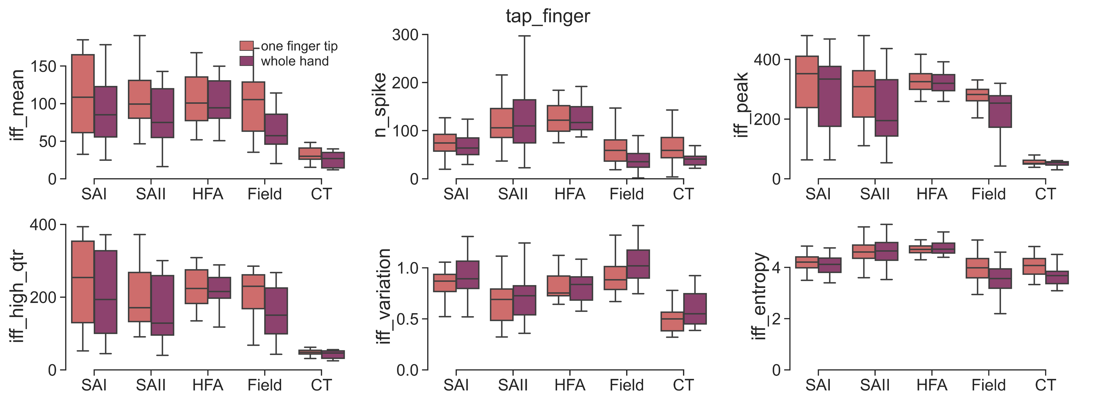

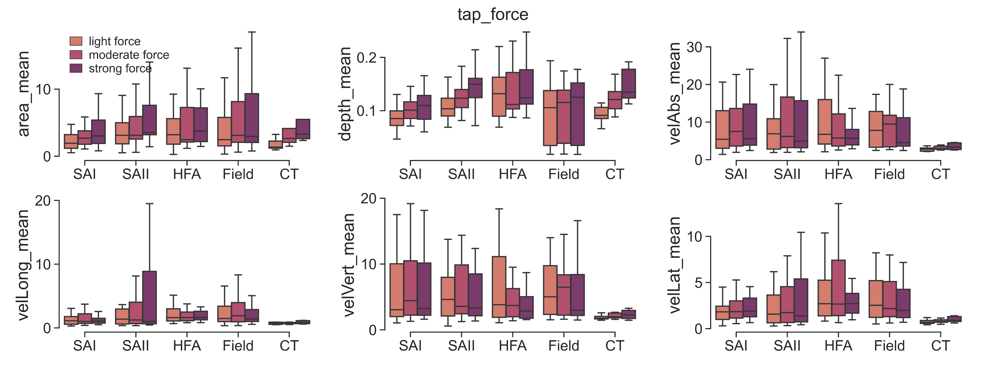
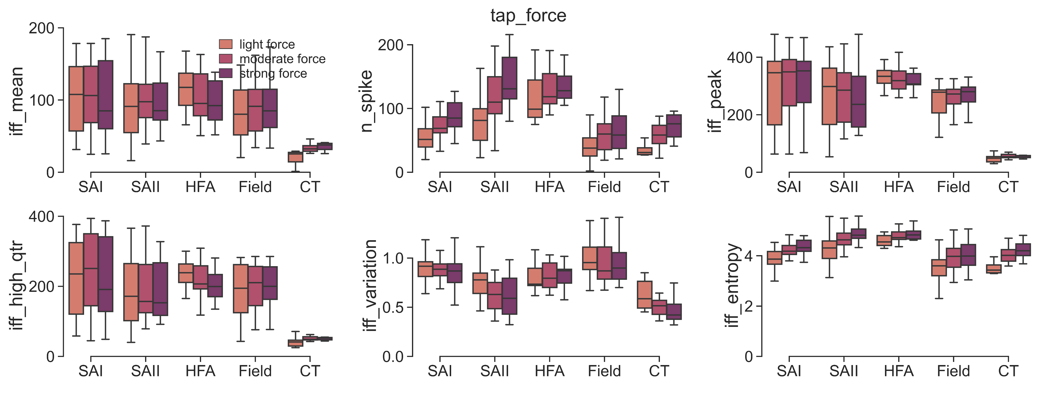
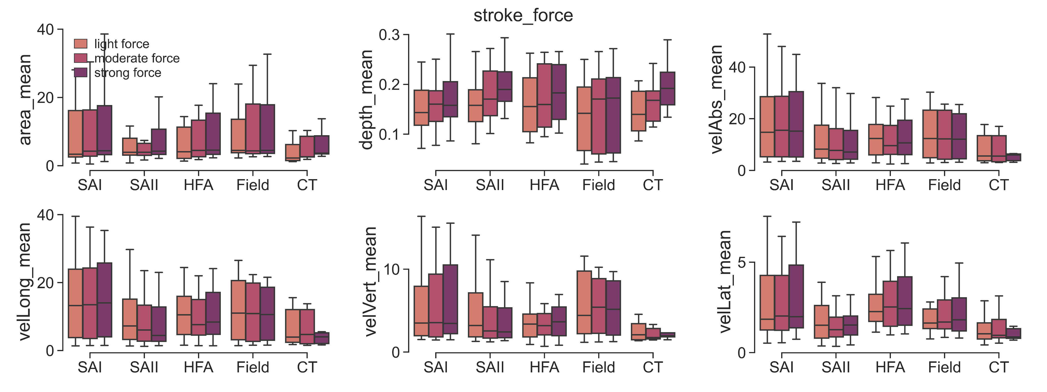
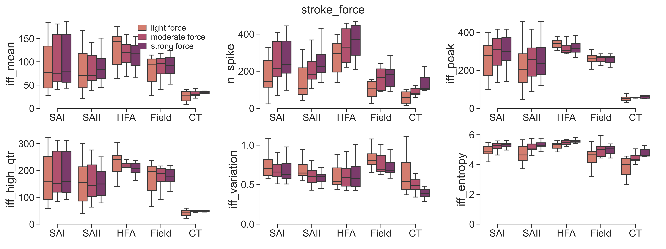
Stroking
Tapping
Notes:
semi_control_IFF_stats.py
plot_neural_features(adapt_method=VarGaussianMix', split_gesture=False, per_repeat=False)
plot_contact_features(adapt_method='VarGaussianMix', split_gesture=False, per_repeat=False)

Slide 4
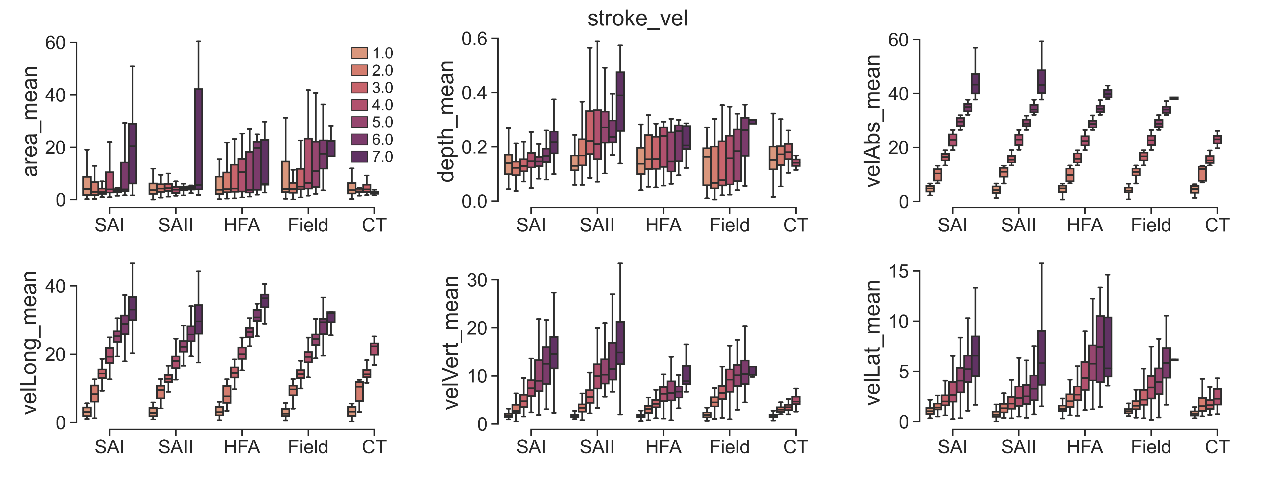
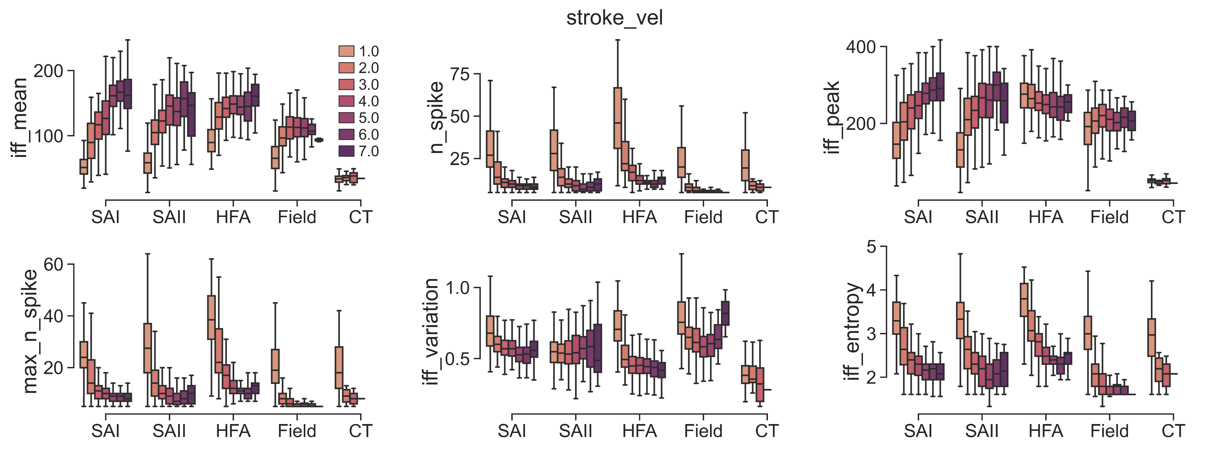
Notes:
semi_control_IFF_stats.py
plot_neural_features(adapt_method=VarGaussianMix', split_gesture=False, per_repeat=True)
plot_contact_features(adapt_method='VarGaussianMix', split_gesture=False, per_repeat=True)

Slide 5
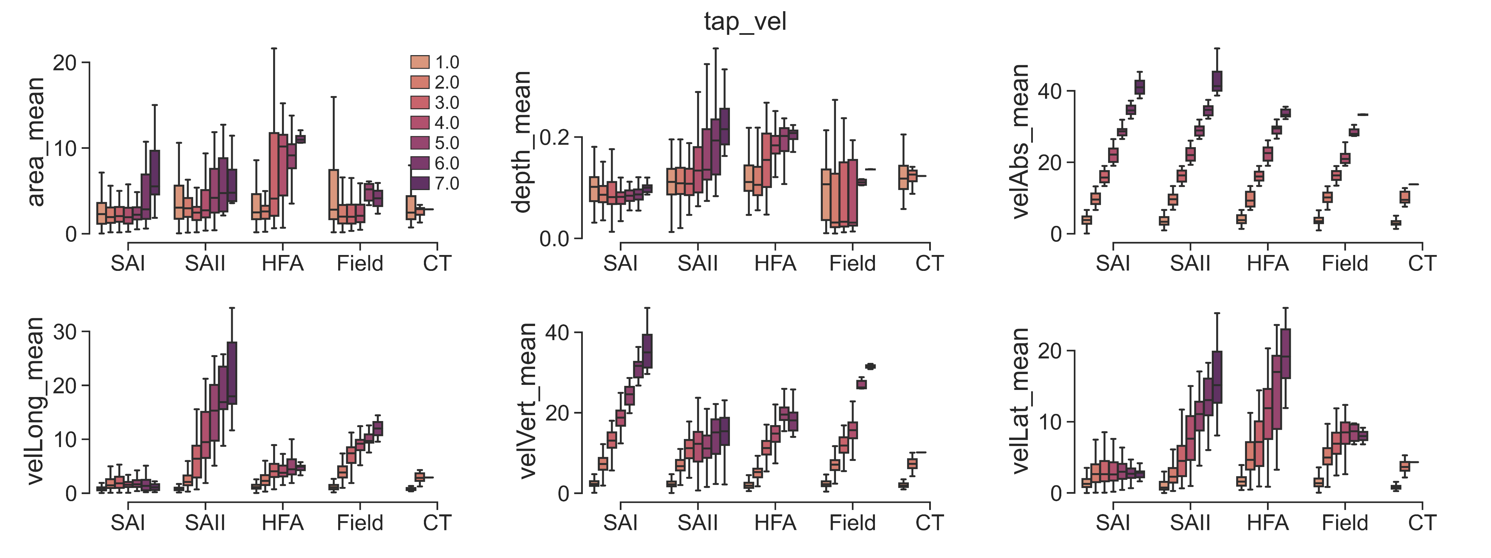
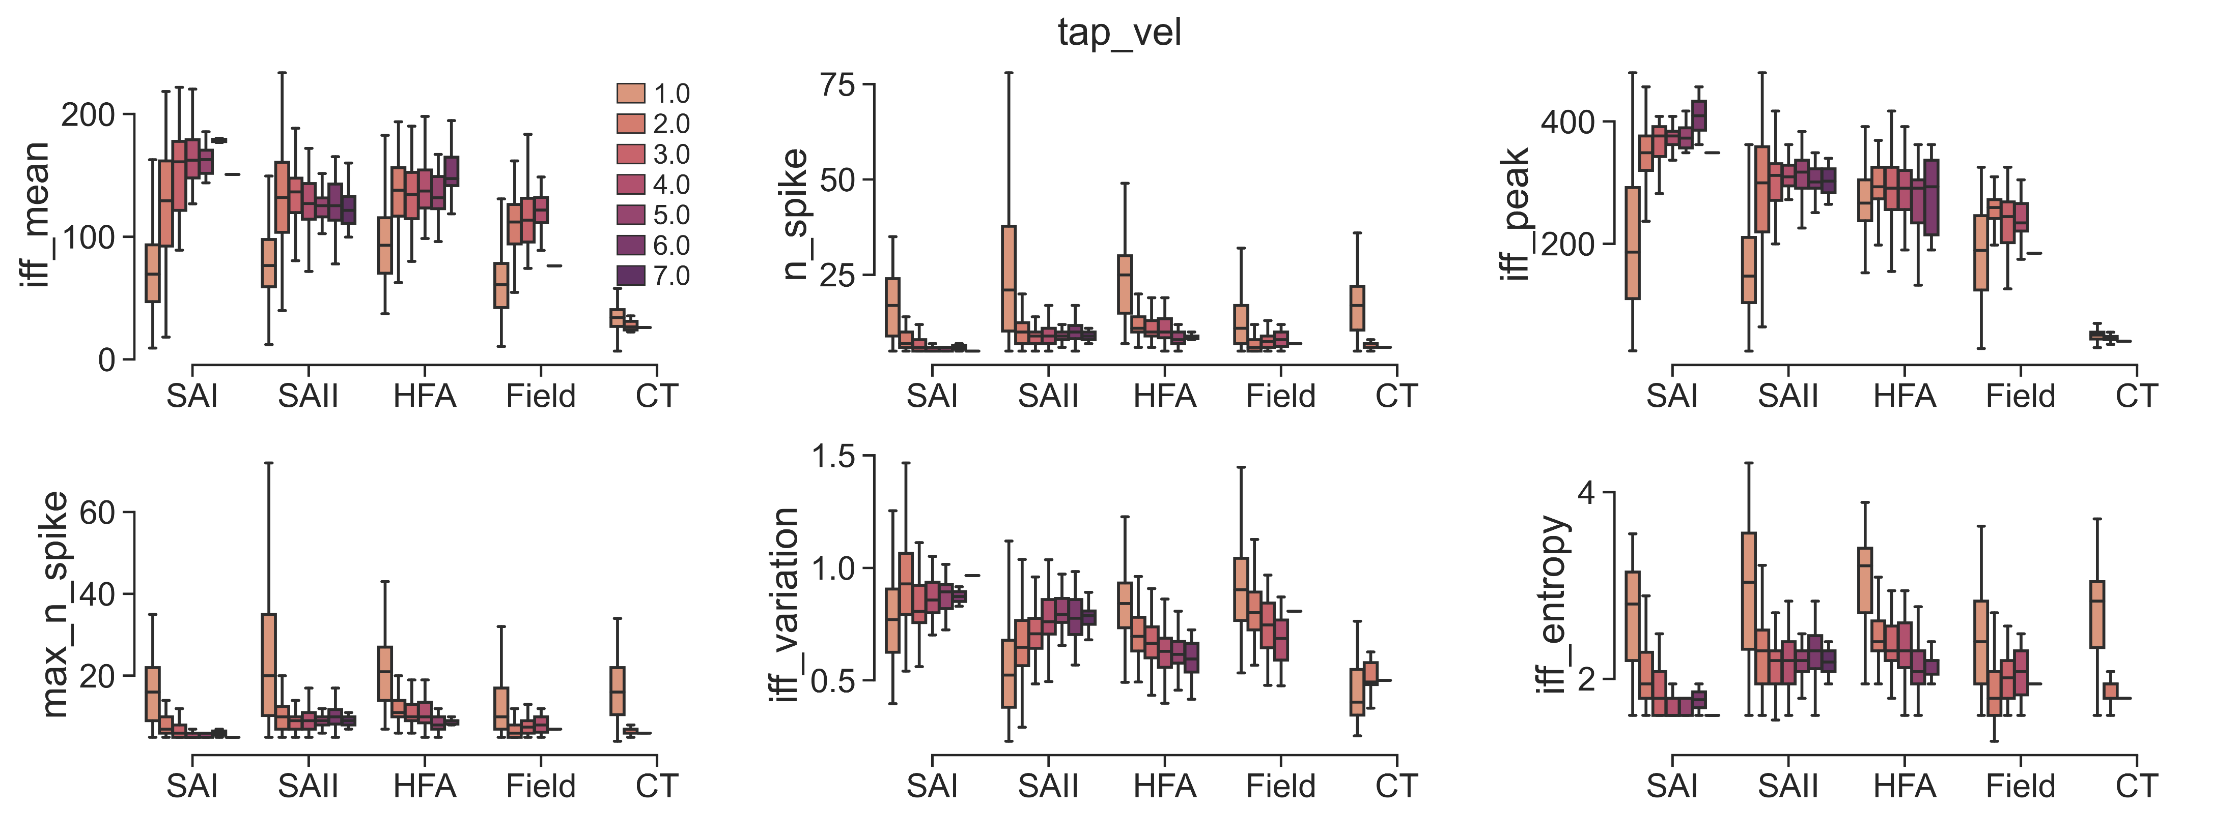
Notes:
semi_control_IFF_stats.py
plot_neural_features(adapt_method=VarGaussianMix', split_gesture=False, per_repeat=True)
plot_contact_features(adapt_method='VarGaussianMix', split_gesture=False, per_repeat=True)

Slide 6
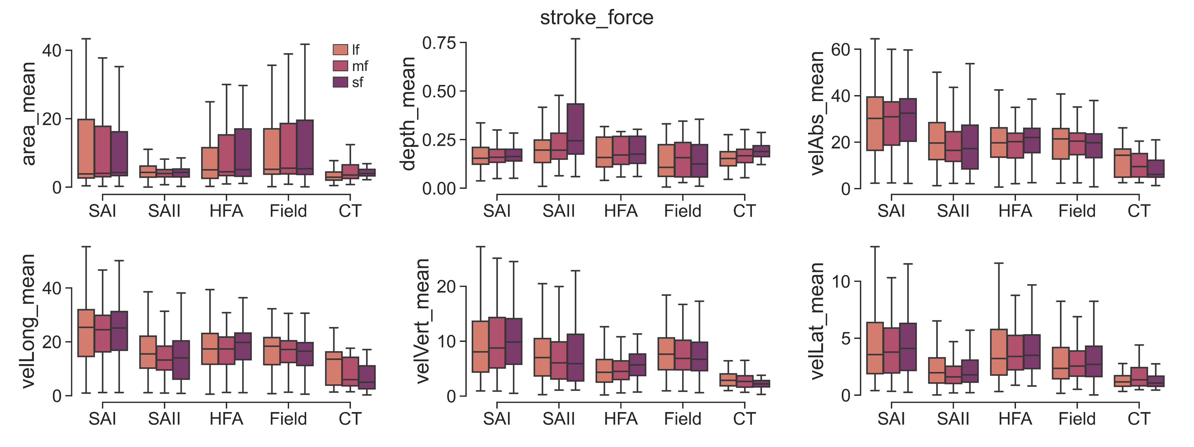
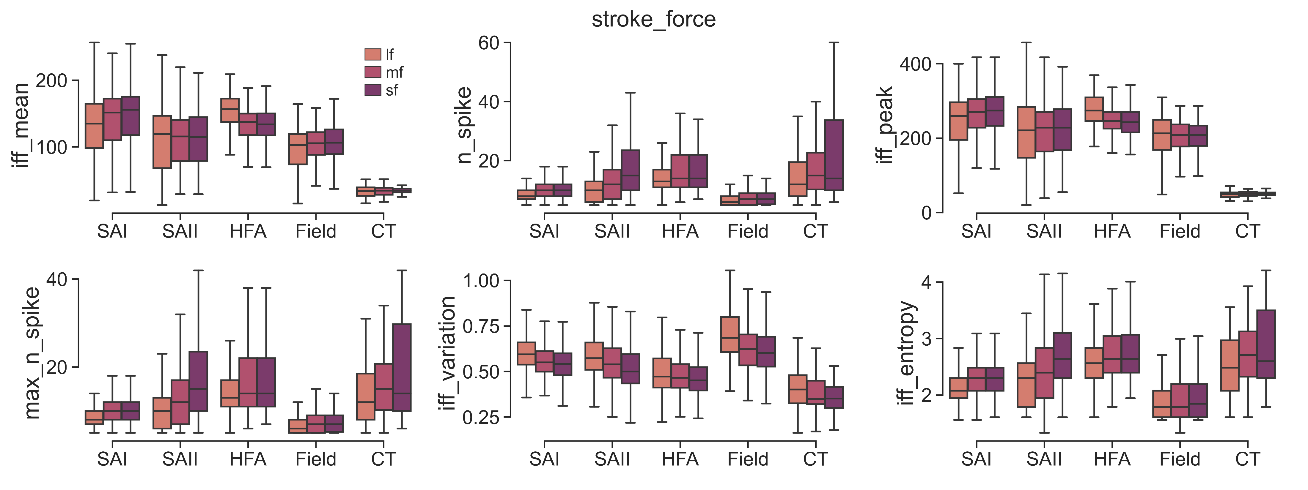
Notes:
semi_control_IFF_stats.py
plot_neural_features(adapt_method=VarGaussianMix', split_gesture=False, per_repeat=True)
plot_contact_features(adapt_method='VarGaussianMix', split_gesture=False, per_repeat=True)

Slide 7
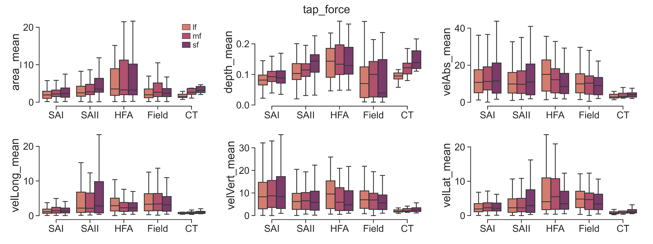
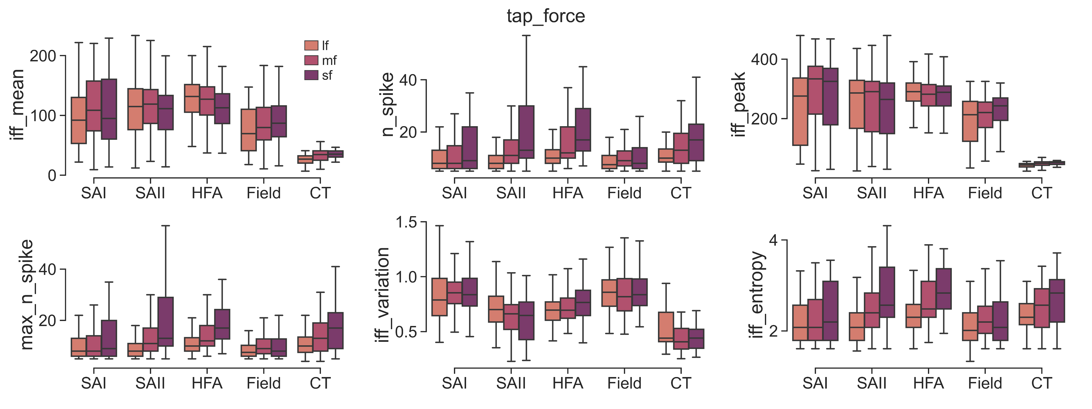
Notes:
semi_control_IFF_stats.py
plot_neural_features(adapt_method=VarGaussianMix', split_gesture=False, per_repeat=True)
plot_contact_features(adapt_method='VarGaussianMix', split_gesture=False, per_repeat=True)

Slide 8
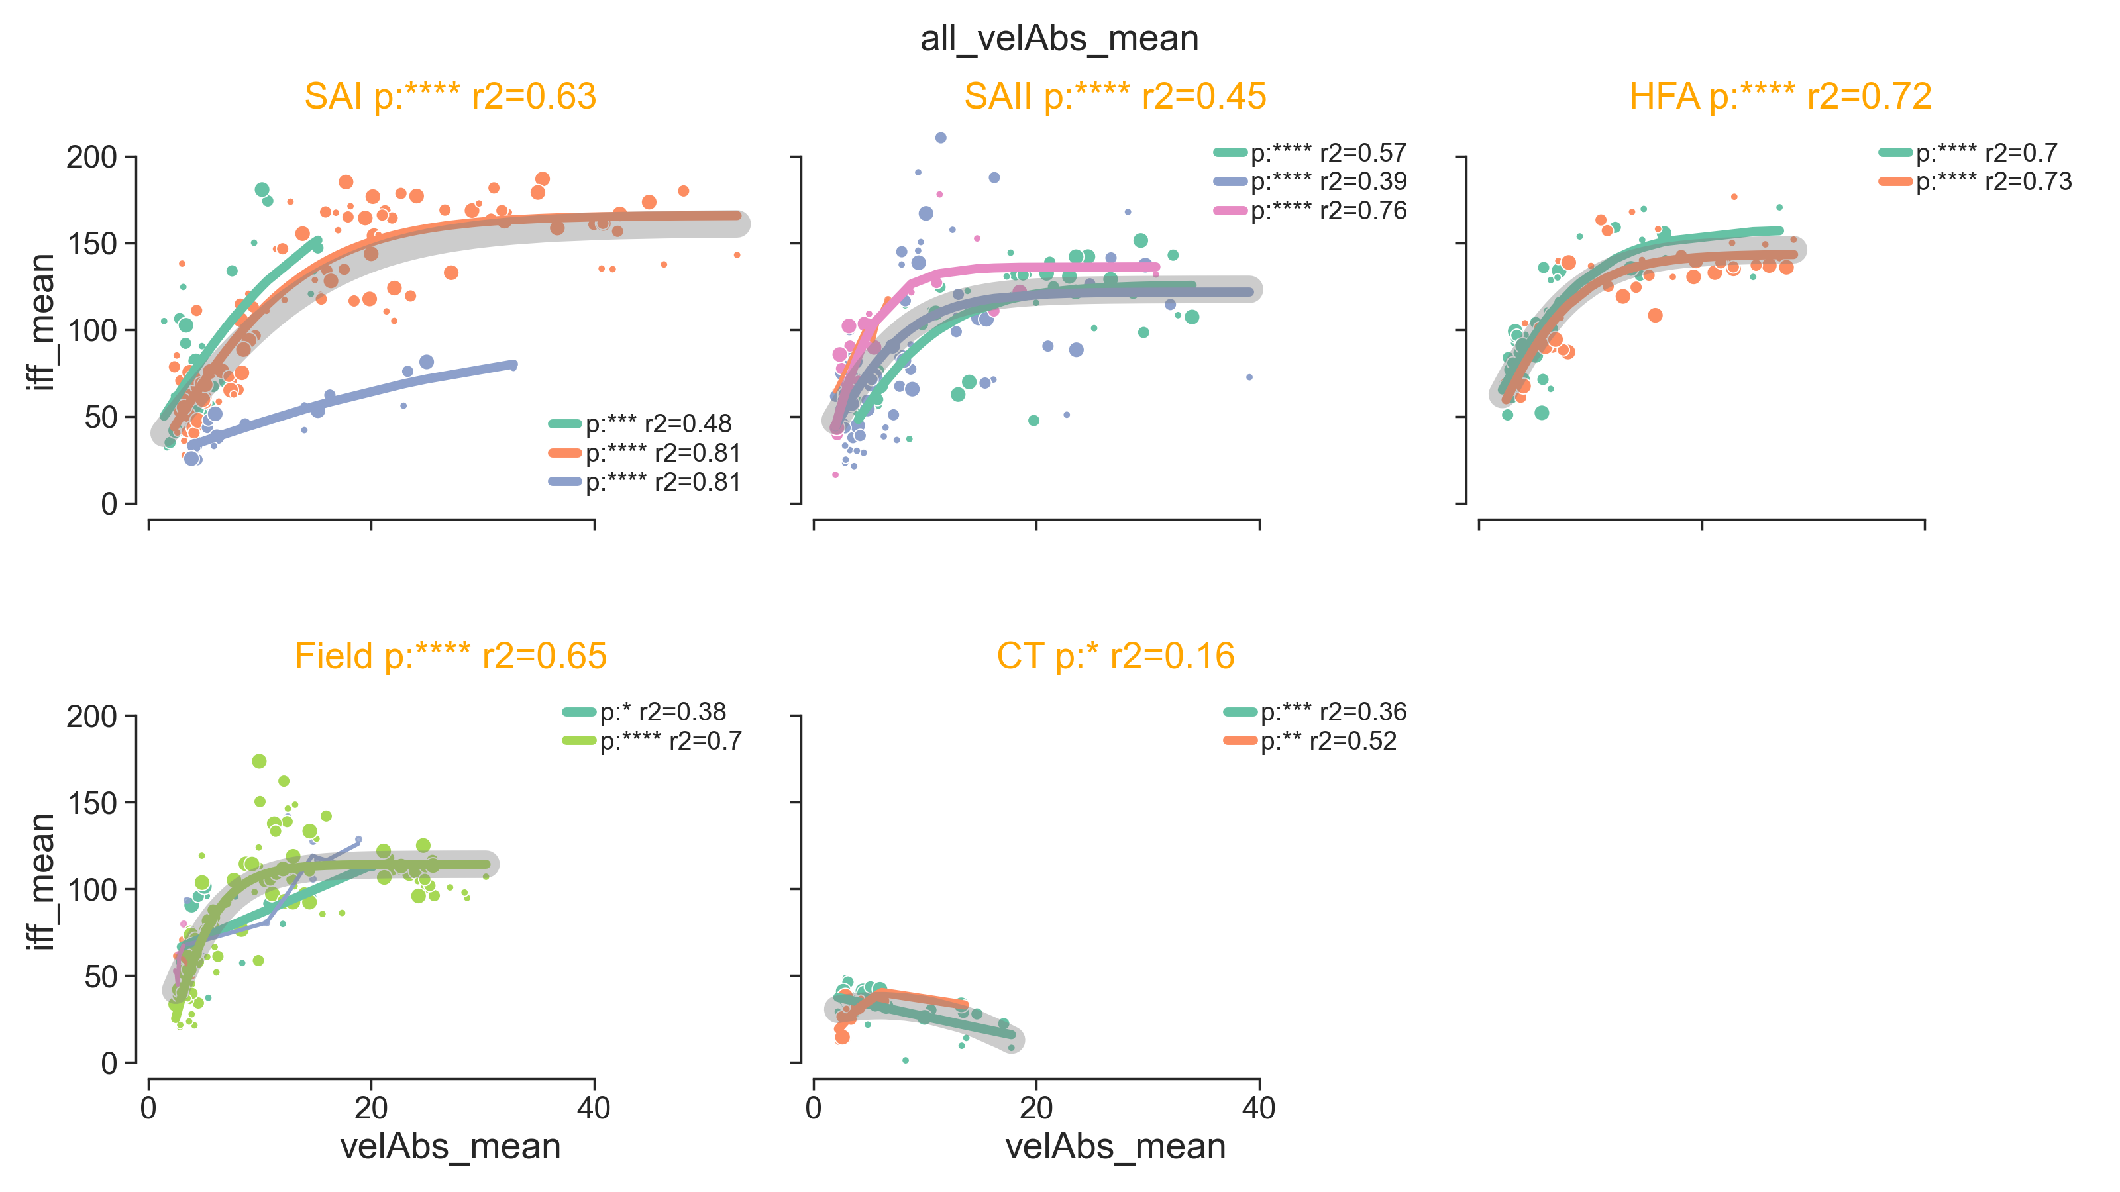
Notes:
semi_control_IFF.py
adapt_contact_condition(method='actual', split_gesture=False, per_repeat=Flase, vis=True)

Slide 9
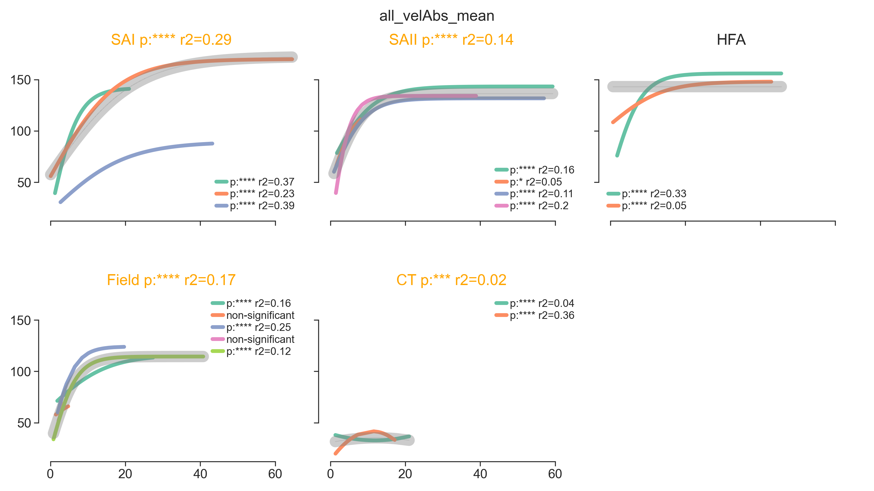
Notes:
semi_control_IFF.py
adapt_contact_condition(method='actual', split_gesture=False, per_repeat=True, vis=True)

Slide 10
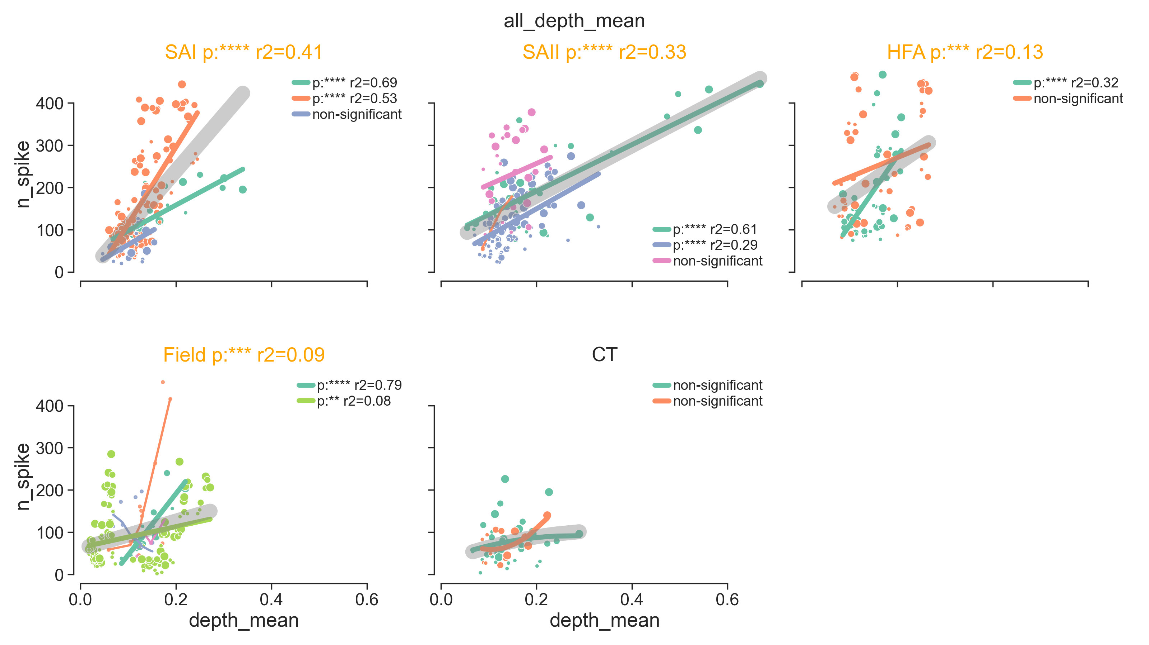
Notes:
semi_control_IFF.py
adapt_contact_condition(method='actual', split_gesture=False, per_repeat=Flase, vis=True)

Slide 11
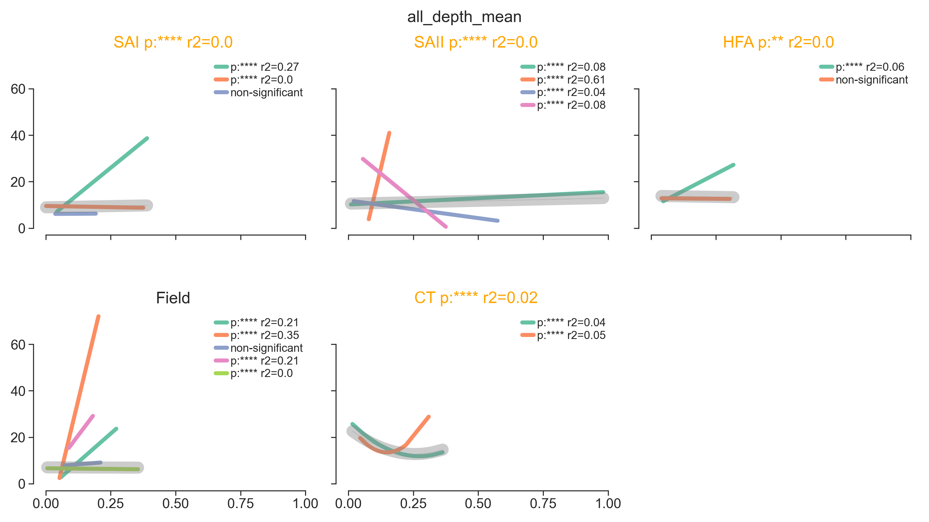
Notes:
semi_control_IFF.py
adapt_contact_condition(method='actual', split_gesture=False, per_repeat=True, vis=True)

Slide 12
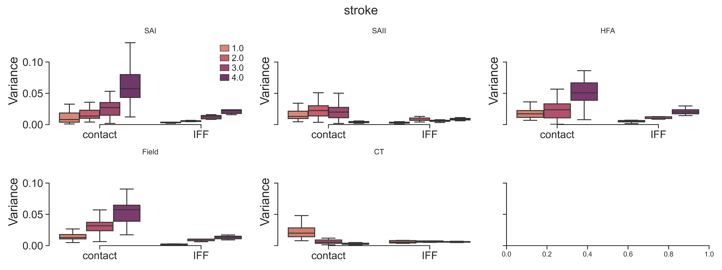
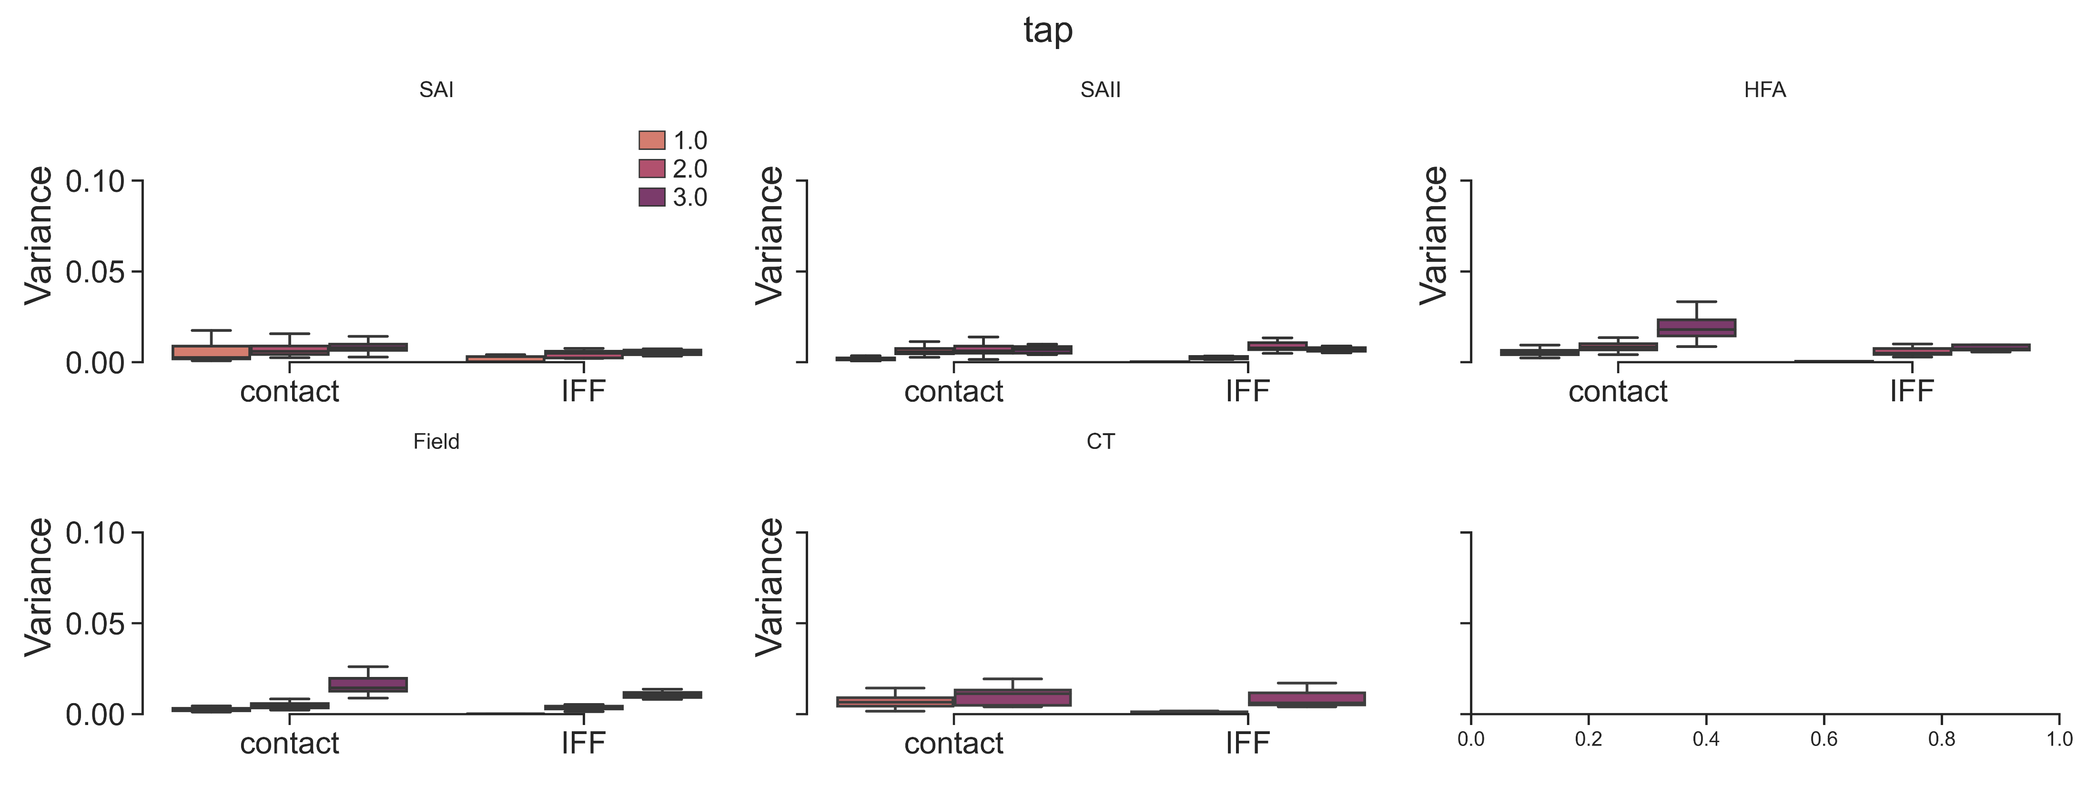
Compare the variance of contact attributes and IFF across controlled contact conditions
SAI
SAII
HFA
Stroking
Field
CT
SAI
SAII
HFA
Tapping
Field
CT
Variance of IFFs exhibits a small range, which is stable regardless of the variance of contact
Notes:
semi_control_IFF_stats.py
get_variance(adapt_method=VarGaussianMix', split_gesture=False, per_repeat=False) plot_variance(adapt_method=VarGaussianMix', split_gesture=False, per_repeat=False)

Slide 13
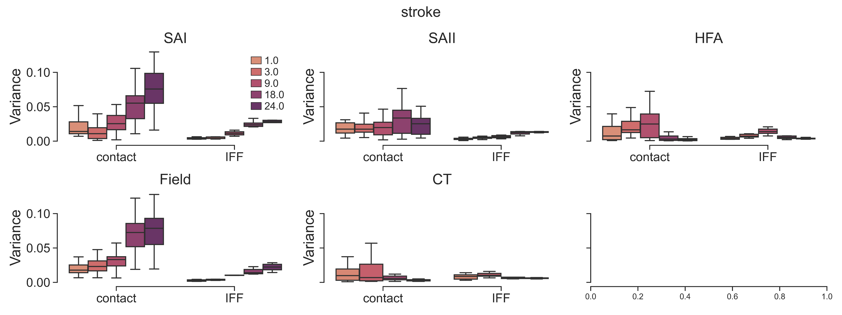
Compare the variance of contact attributes and IFF across controlled contact conditions
SAI
SAII
HFA
Stroking
Field
CT
SAI
SAII
HFA
Tapping
Field
CT
Variance of IFFs exhibits a small range, which is stable regardless of the variance of contact
Notes:
semi_control_IFF_stats.py
get_variance(adapt_method=VarGaussianMix', split_gesture=False, per_repeat=True) plot_variance(adapt_method=VarGaussianMix', split_gesture=False, per_repeat=True)

Slide 14
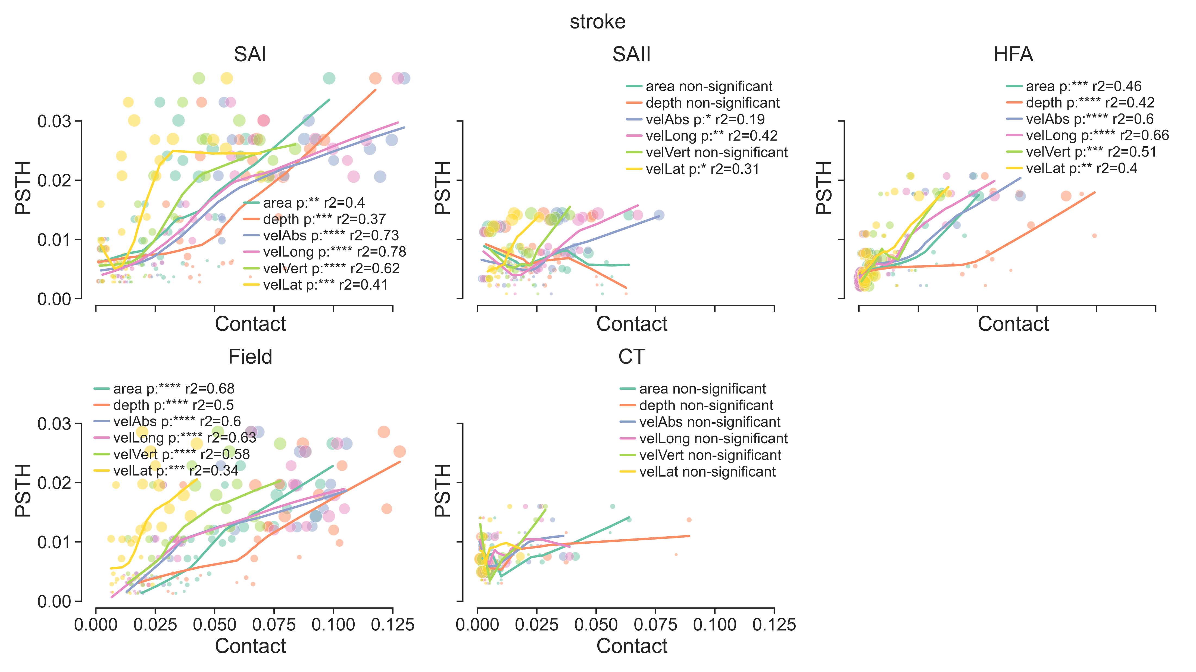
Notes:
semi_control_IFF_stats.py
plot_variance(adapt_method=VarGaussianMix', split_gesture=False, per_repeat=False)

Slide 15
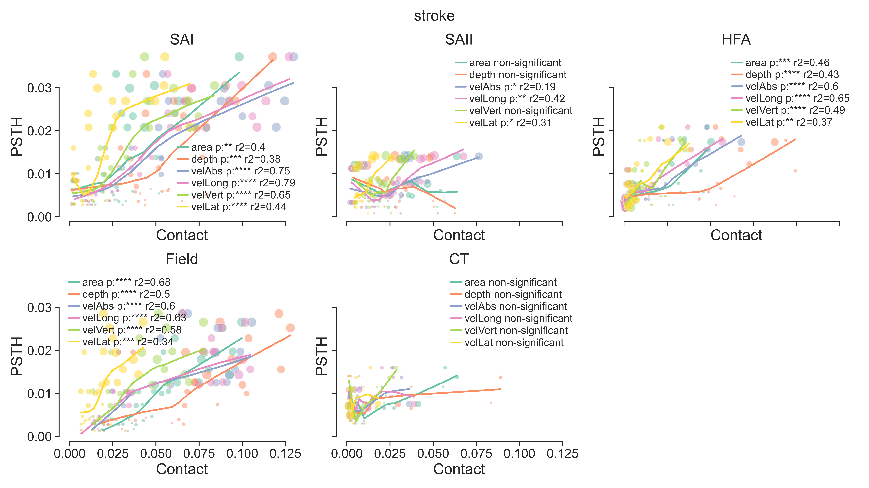
Notes:
semi_control_IFF_stats.py
plot_variance(adapt_method=VarGaussianMix', split_gesture=False, per_repeat=True)

Slide 16
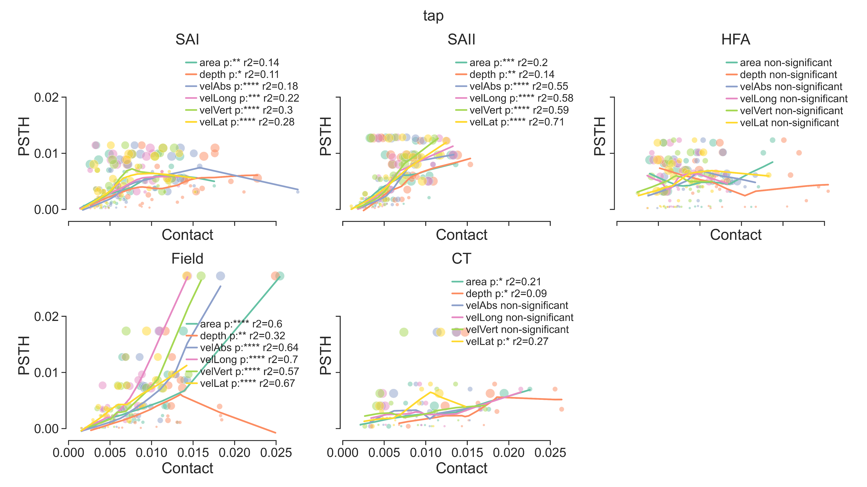
Notes:
semi_control_IFF_stats.py
plot_variance(adapt_method=VarGaussianMix', split_gesture=False, per_repeat=False)

Slide 17
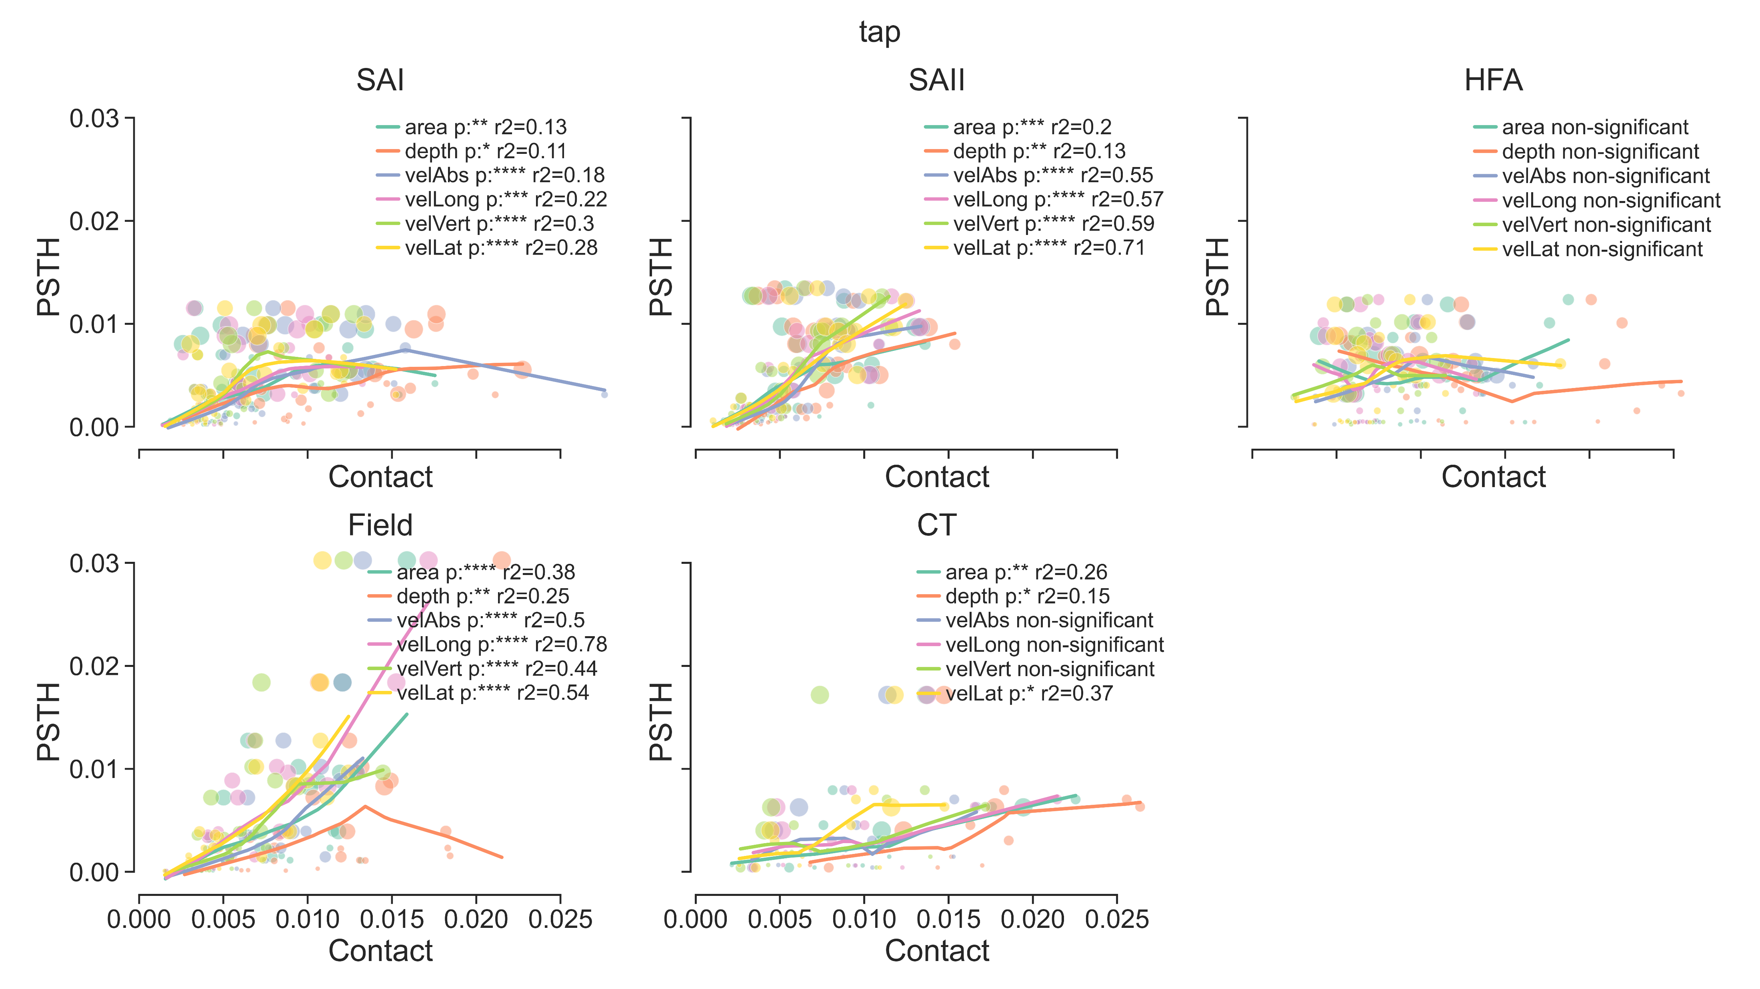
Notes:
semi_control_IFF_stats.py
plot_variance(adapt_method=VarGaussianMix', split_gesture=False, per_repeat=True)

Slide 18
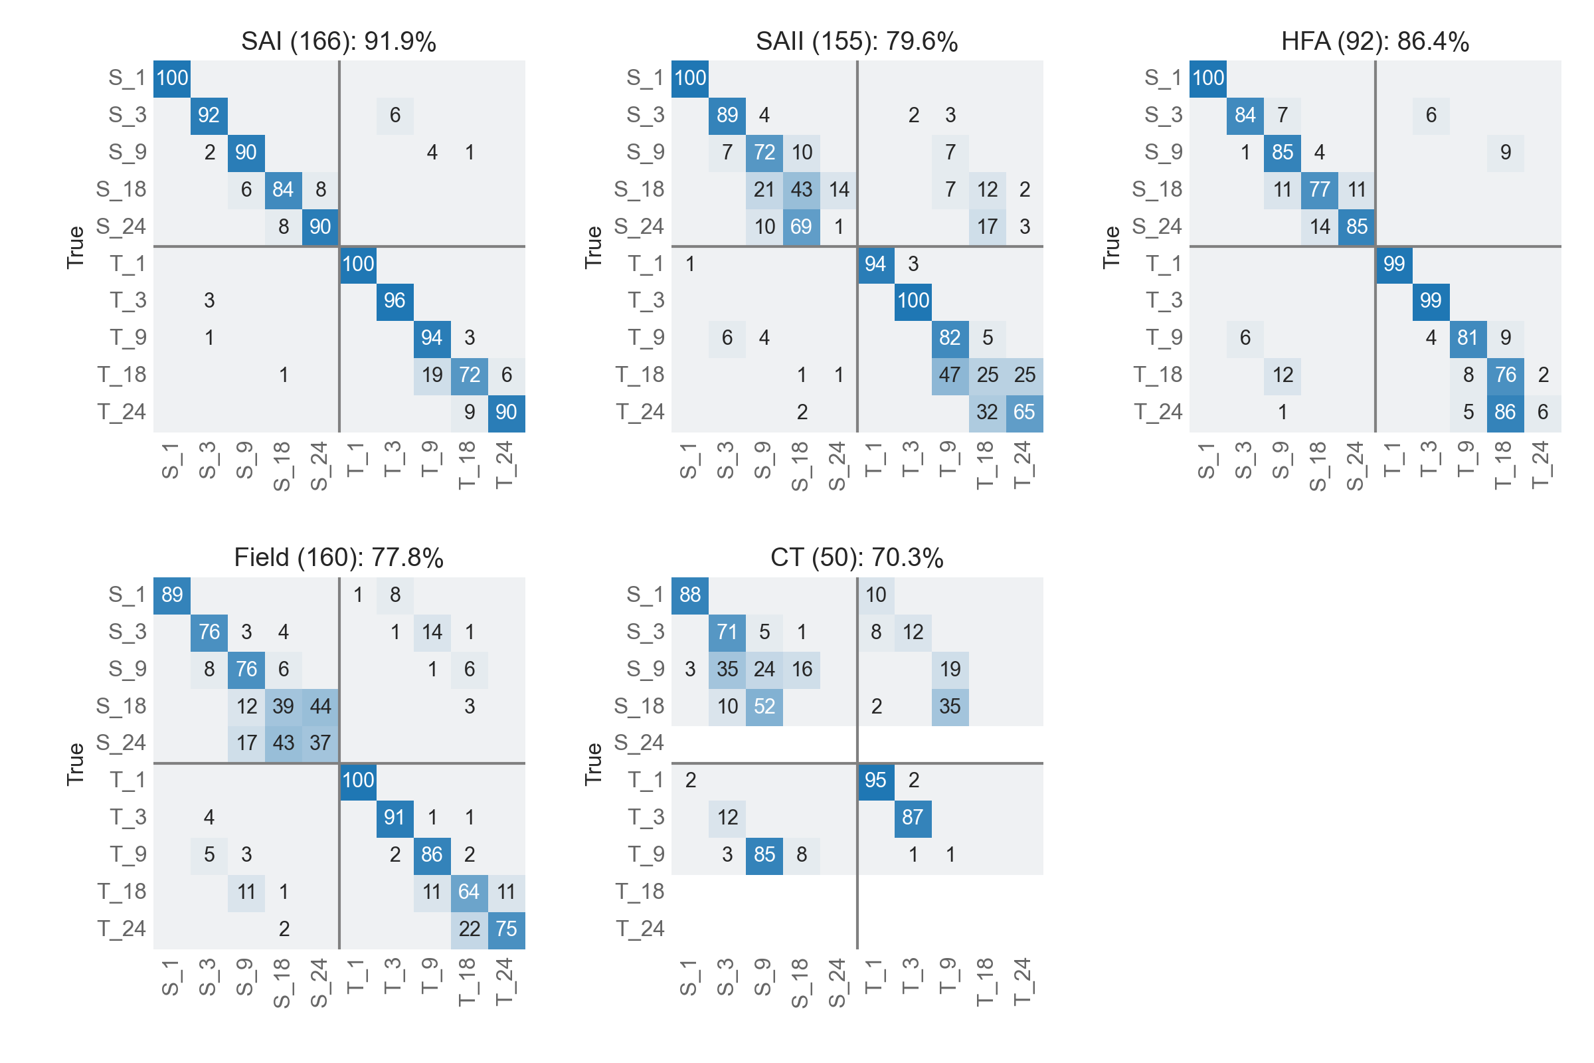
Actual vel label:
IFF features:
iff_mean,
iff_variation,
n_spike,
max_n_spike,
iff_high_qtr,
peak,
iff_entropy,
freq_max,
freq_amp_max,
freq_centroid,
freq_entropy
Notes:
semi_control_IFF.py
clf_contact_condition(data_source='neural', clf_method='RF', adapt_method='actual', split_gesture=False, apply_pca=False, per_repeat=False)

Slide 19
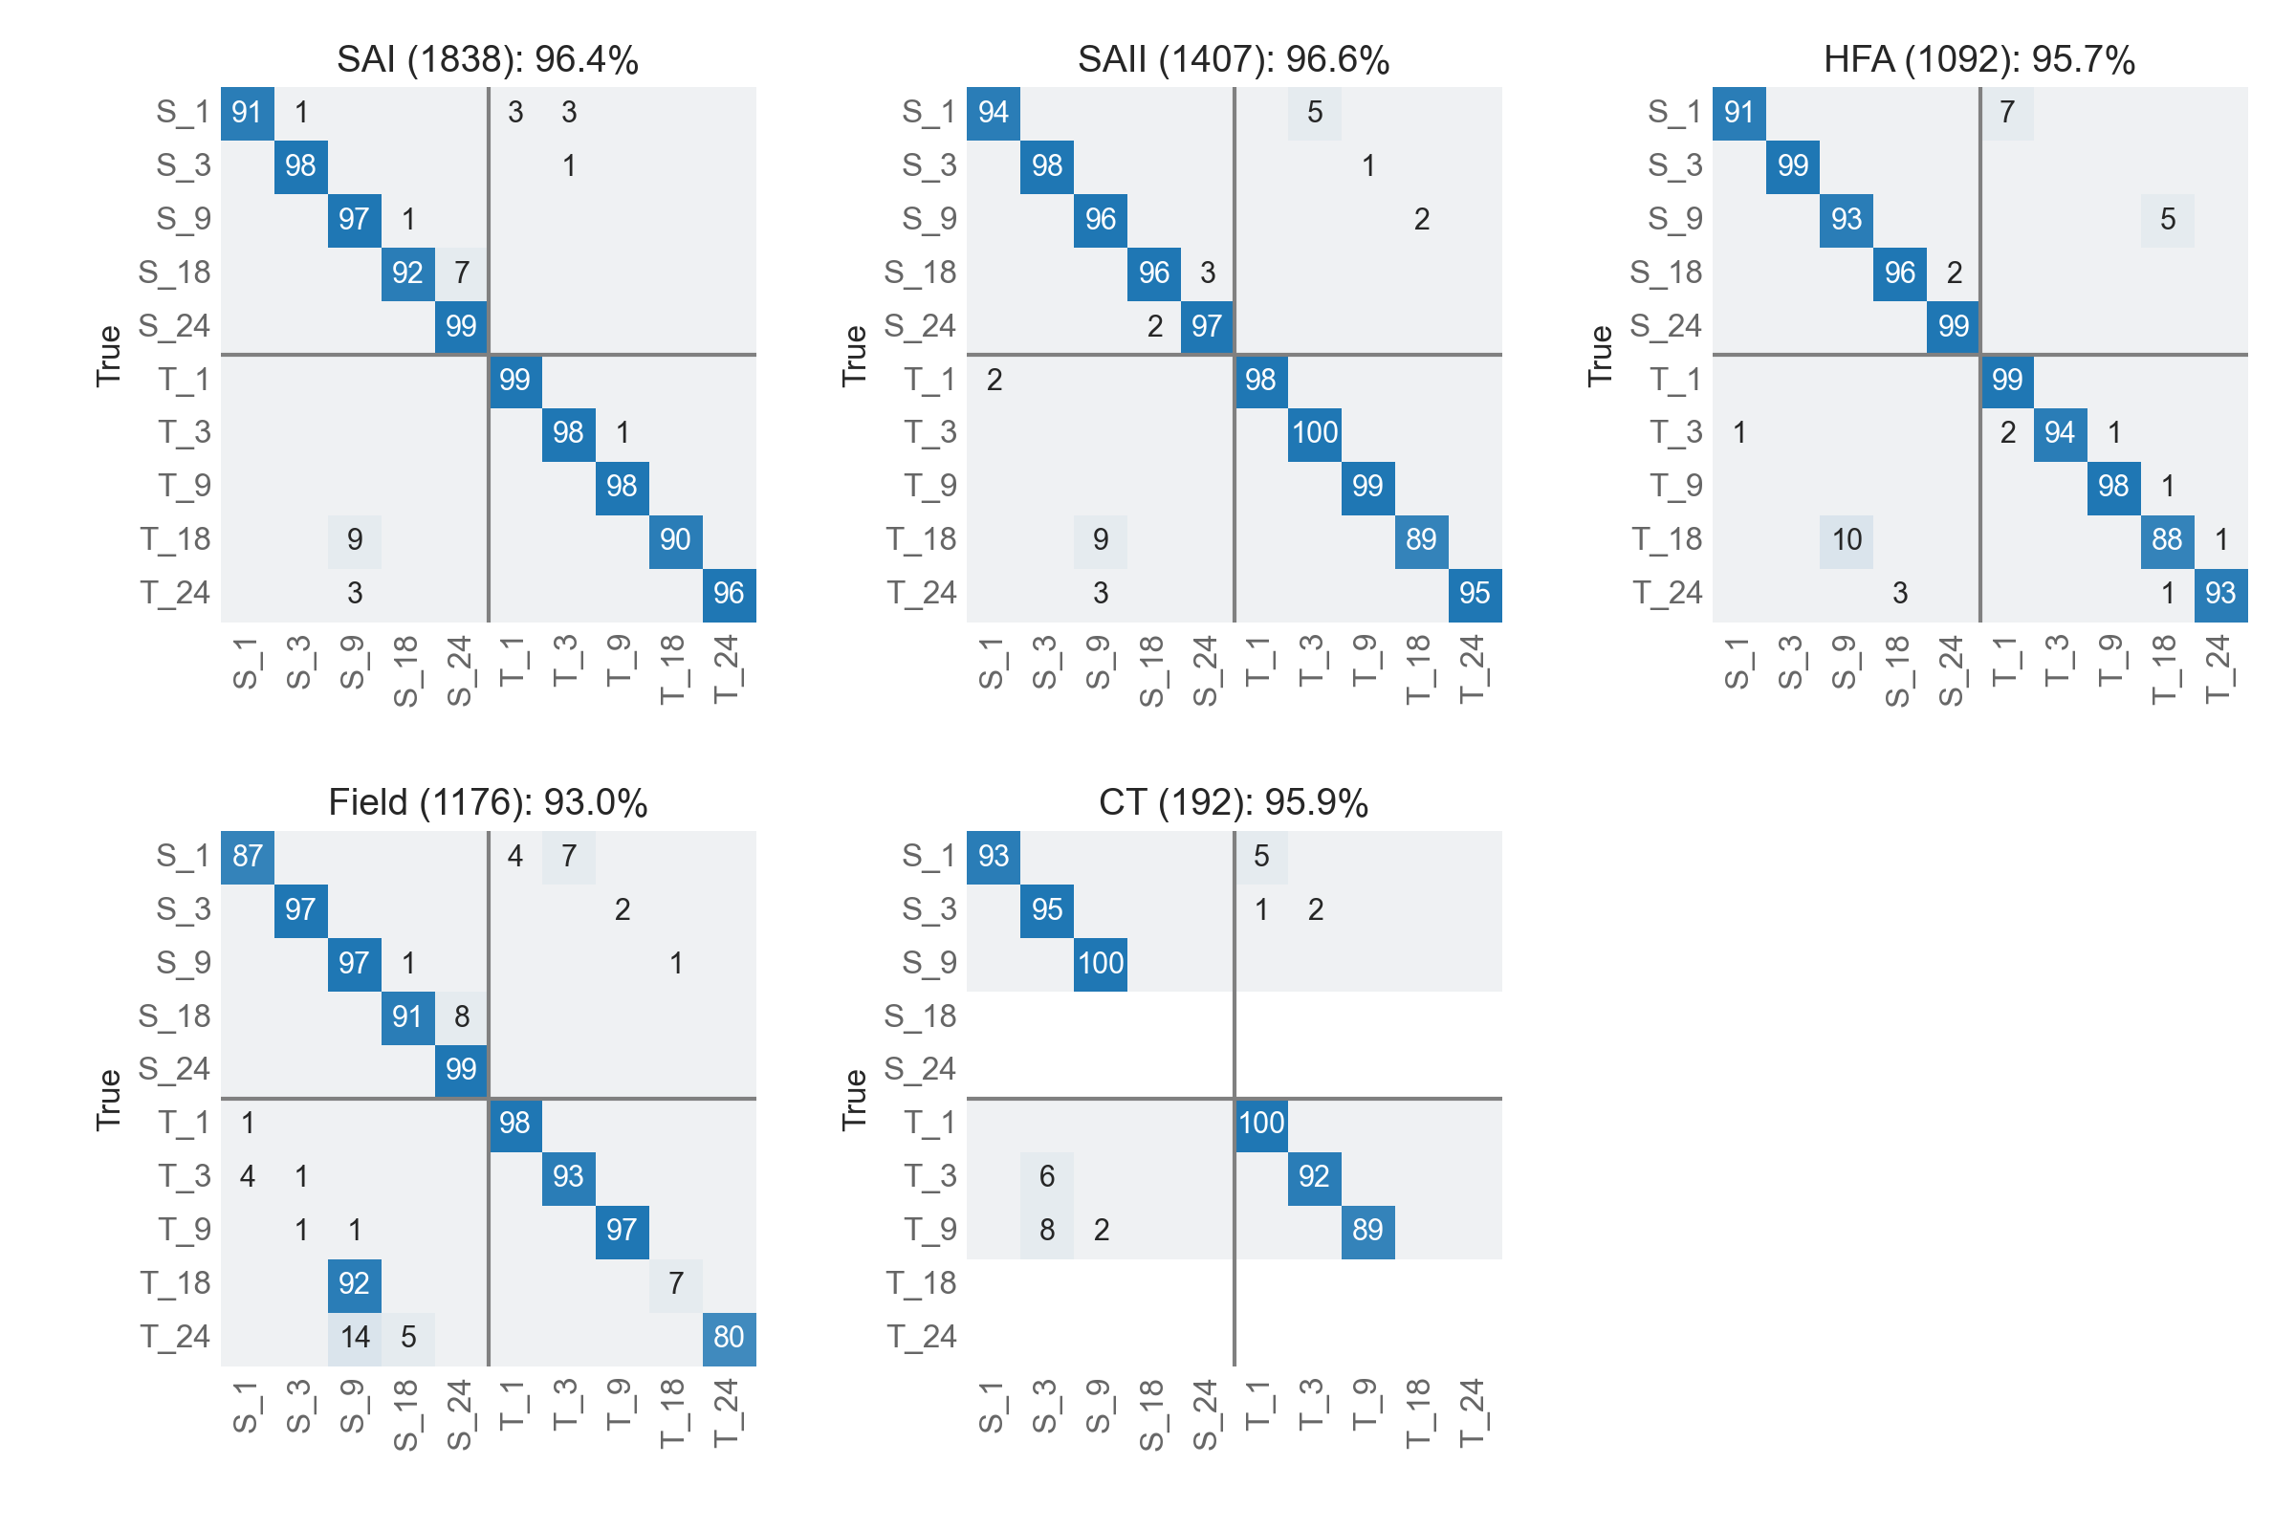
Actual vel label:
IFF features:
iff_mean,
iff_variation,
n_spike,
max_n_spike,
iff_high_qtr,
peak,
iff_entropy,
freq_max,
freq_amp_max,
freq_centroid,
freq_entropy
Notes:
semi_control_IFF.py
clf_contact_condition(data_source='neural', clf_method='RF', adapt_method='actual', split_gesture=False, apply_pca=False, per_repeat=True)

Slide 20
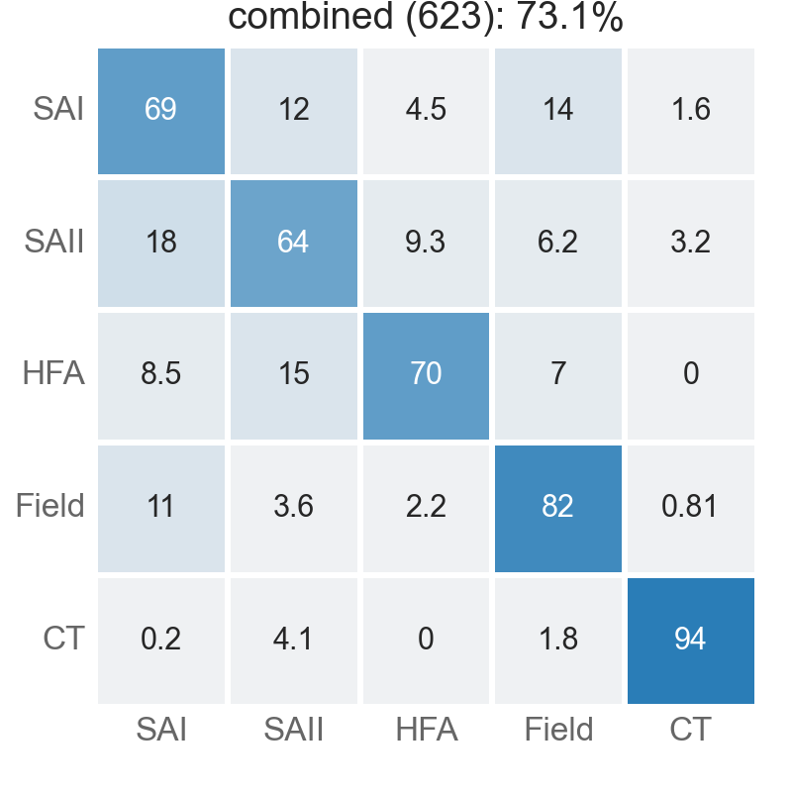
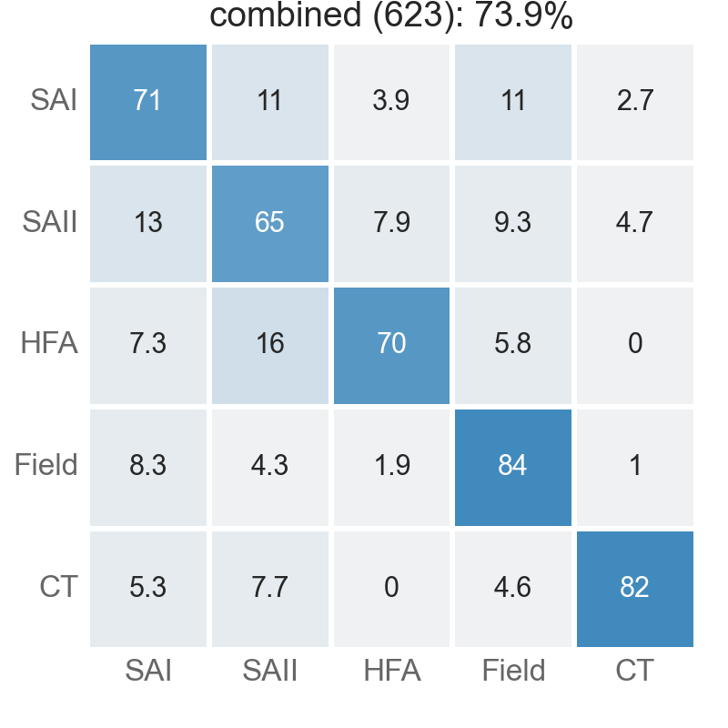
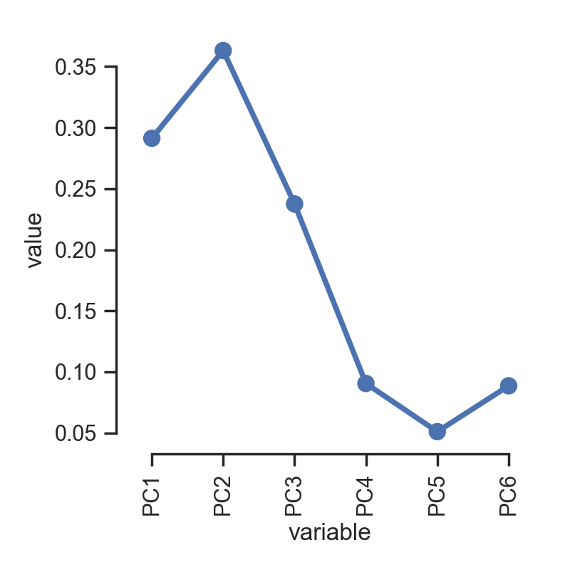
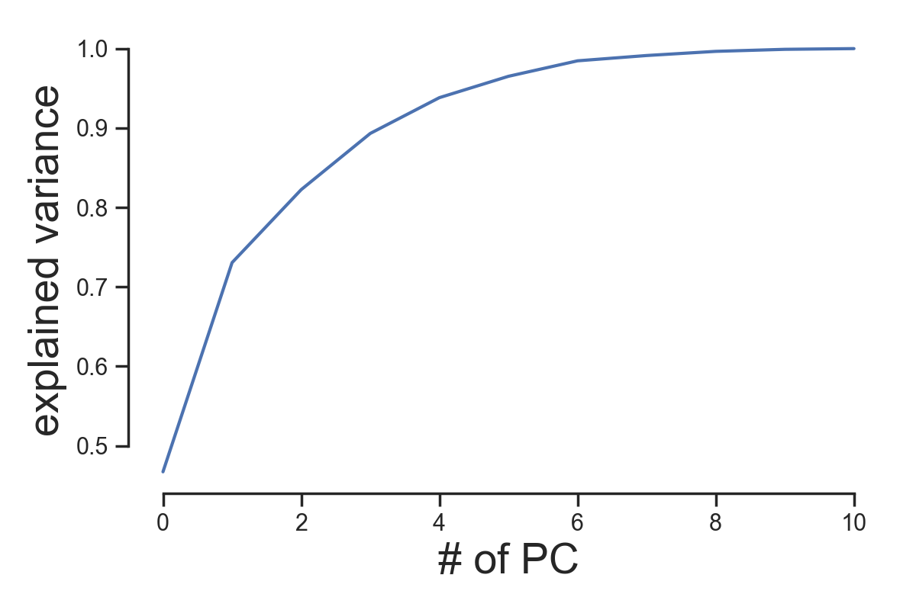
Actual vel label:
IFF features
iff_mean,
iff_variation,
n_spike,
max_n_spike,
iff_high_qtr,
peak,
iff_entropy,
freq_max,
freq_amp_max,
freq_centroid,
freq_entropy
Actual vel label:
PC1-6
Feature Importance
Notes:
semi_control_IFF.py
clf_neuron_type(clf_method='RF', adapt_method='actual', split_gesture=False, apply_pca=False, per_repeat=False)
clf_neuron_type(clf_method='RF', adapt_method='actual', split_gesture=False, apply_pca=True, per_repeat=False)

Slide 21
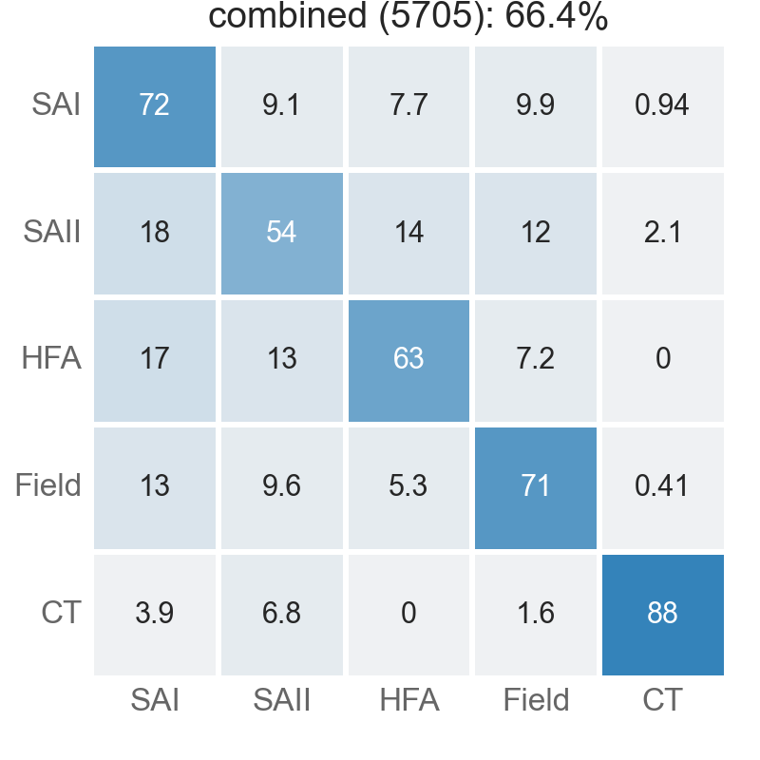
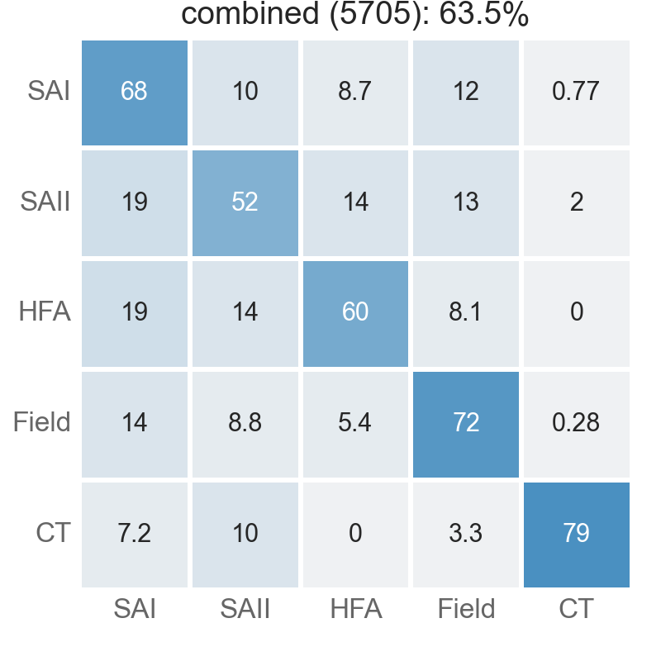
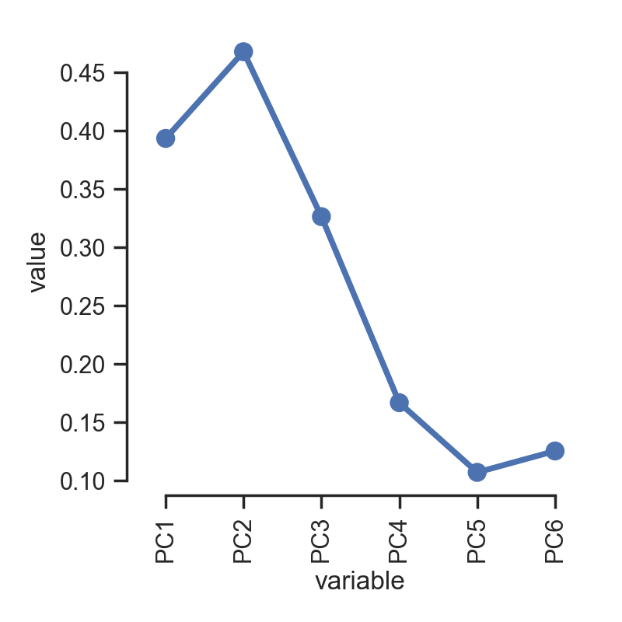
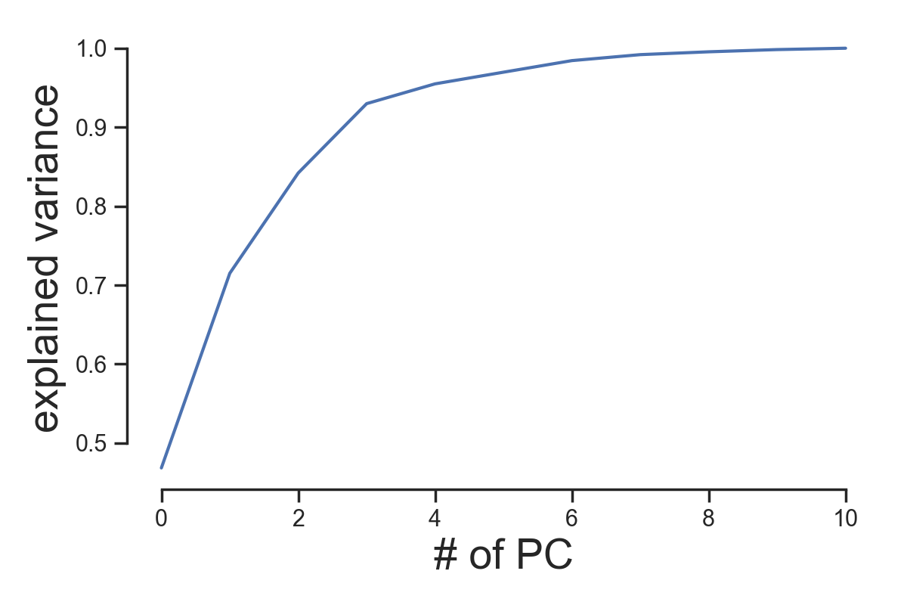
Actual vel label:
IFF features
iff_mean,
iff_variation,
n_spike,
max_n_spike,
iff_high_qtr,
peak,
iff_entropy,
freq_max,
freq_amp_max,
freq_centroid,
freq_entropy
Actual vel label:
PC1-6
Feature Importance
Notes:
semi_control_IFF.py
clf_neuron_type(clf_method='RF', adapt_method='actual', split_gesture=False, apply_pca=False, per_repeat=True)
clf_neuron_type(clf_method='RF', adapt_method='actual', split_gesture=False, apply_pca=True, per_repeat=True)

Slide 22


Notes:
semi_control_IFF.py
clf_neuron_type(clf_method='RF', adapt_method='actual', split_gesture=False, apply_pca=True, per_repeat=False)

Slide 23


Notes:
semi_control_IFF.py
clf_neuron_type(clf_method='RF', adapt_method='actual', split_gesture=False, apply_pca=True, per_repeat=True)

Slide 24





















Linear Regression
Linear Nonlinear Poisson
Fit linear filter (conv kernel)
Invert Poisson link
0.05 s bin
0.15 s bin
0.4 s bin
Notes:
main.py
plot_class = plot_results(run_mode='per_unit', method='LR_LNP')

Slide 25


Linear Regression
Linear Nonlinear Poisson
Fit linear filter (conv kernel)
Invert Poisson link
0.05 s bin
0.15 s bin
0.4 s bin
Notes:
main.py
plot_class = plot_results(run_mode='per_trial', method='LR_LNP')

Slide 26


Slide 27


